Slide 1
An Introduction to
EU Economics

Slide 2
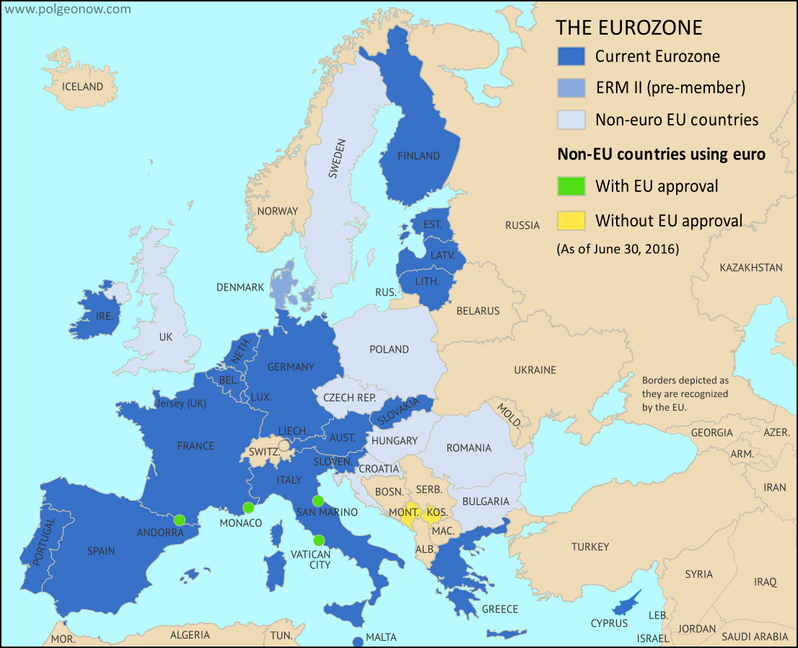

Slide 3
Landmarks in EU History
Deep Background
  Roman Era/European Nation States
  WWI + WWII
  Bretton Woods Agreement/Fixed Exchange Rates (until 1970s)
European Community 1967
  GER, FRA, BEL, ITA, LUX, NED
  1972: DEN, IRE, UK
  1980s: GRE, PORT, ESP, AUS, SWE
European Union (1992 Maastricht Treaty Plan/Conditions)
  Inflation & Fiscal Targets
Pact for Stability and Growth (1997)
  Deficits < 3% of GDP; Debt < 60% of GDP
Monetary System
  European Central Bank (1998)
  Euro 1999 (unit) /2002 (medium)

Slide 4
What Is/Was The EU?
Common currency area
  + Open (low barriers) economic zone
+ Area of fiscal and regulatory integration
Nation-State overseeing subunits?

Slide 5
EU as Currency Common Currency Area:
Views of Conditions for Successful Common Currency
“Optimal Currency Areas”
(Mundell …)
Credible Commitments
(Cochrane …)
Labor mobility across sub-units
Wage flexibility across sub-units
Fiscal transfers across sub-units
Common currency (fixed exchange) as solution to repeated game problem
Currency value stability
Sub-units responsible for own fiscal commitments

Slide 6
U.S. Common Currency Experience
Sub-unit defaults
Large regional productivity/income differences
Fiscal transfers across sub-units but of limited magnitudes and (many) tied to long run goals rather than business cycle
Regional price differentials

Slide 7
What Is/Was The EU?
Common currency area?
  Open (low barriers) economic zone?
Area of fiscal and regulatory integration?
Nation-State with subunits?
  Responsibilities of individual subunits?
  Responsibilities of ECB/fiscal collective …?

Slide 8
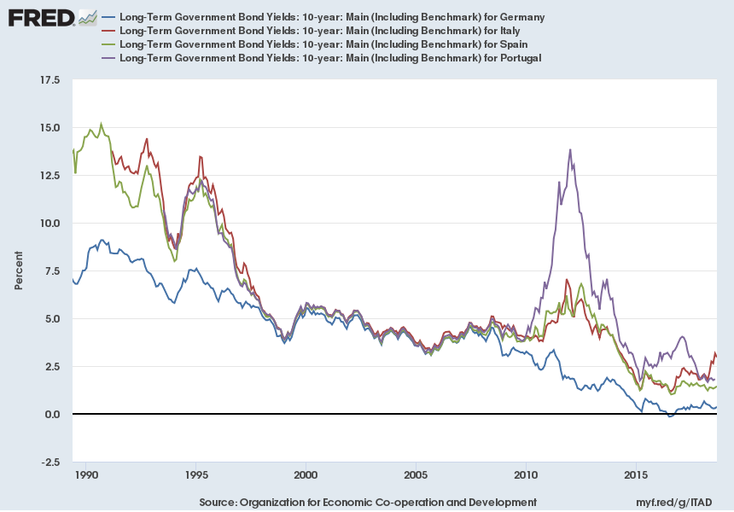
Market Views: (Implicitly) More Than Just Common Currency Area

Slide 9
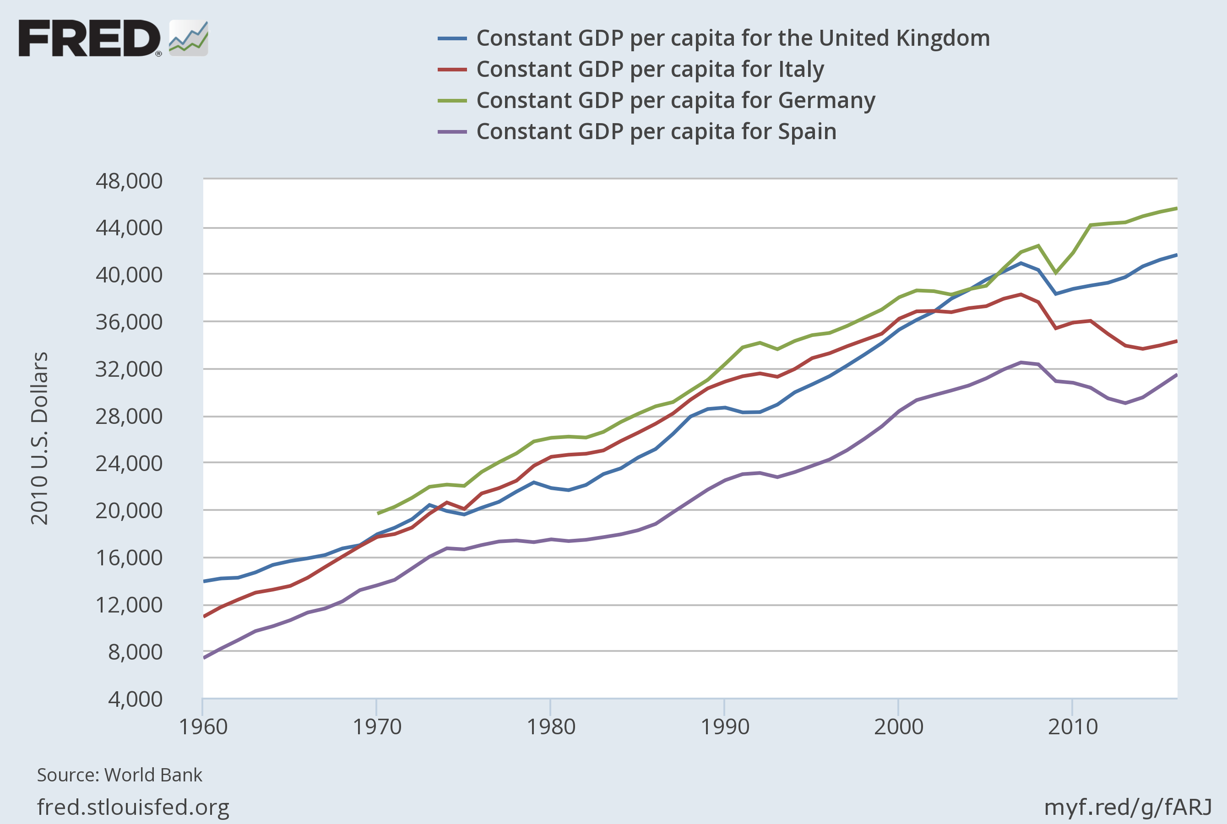
Varied Economic Outcomes in EU:
GDP Per Capita

Slide 10
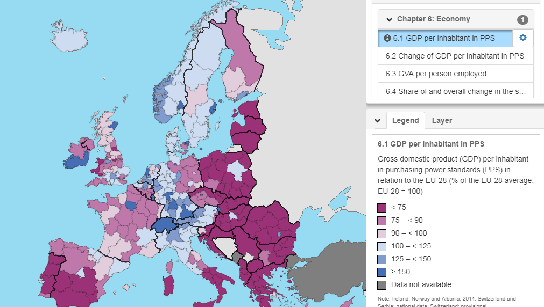
GDP Per Capita as % of EU Average

Slide 11
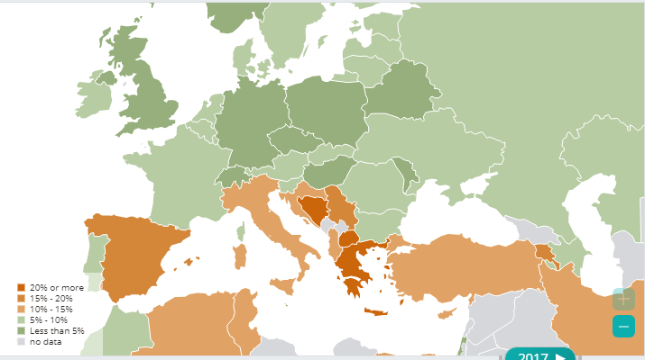
Varied Econ Outcomes in EU:
Unemployment Rates

Slide 12
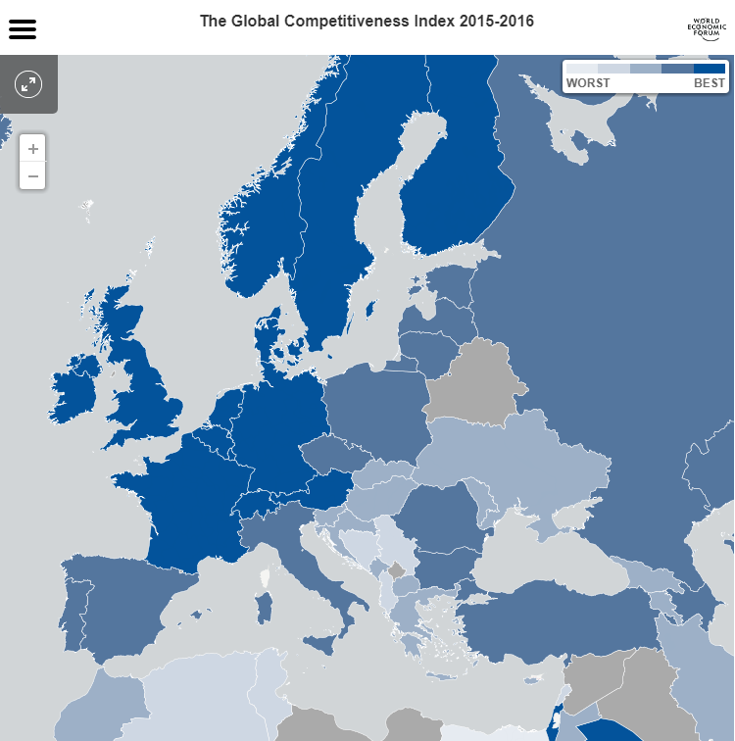
Varied Econ Policy in EU:
Overall Competiveness Index

Slide 13
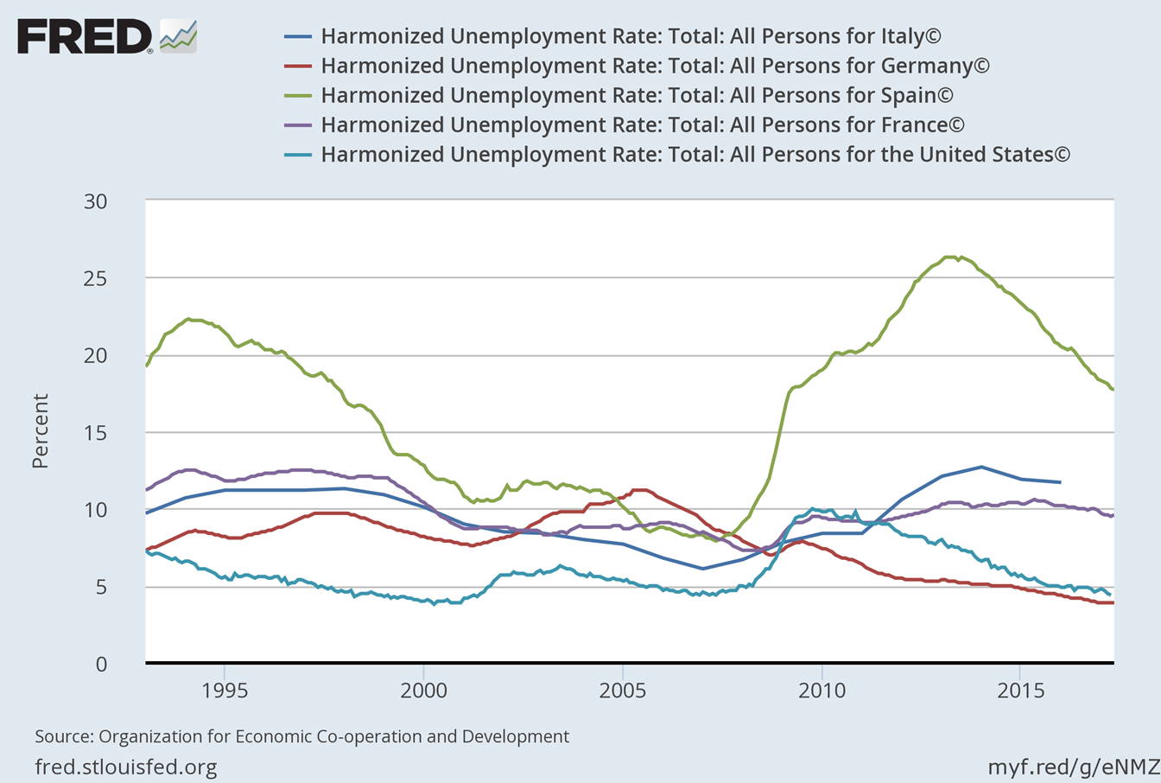
Countries with Higher Labor “Protections”
Have Higher Unemployment rates
Country Rank in Labor Market Efficiency
By Global Economic Forum
92nd
121rst
51rst
4th
28th

Slide 14
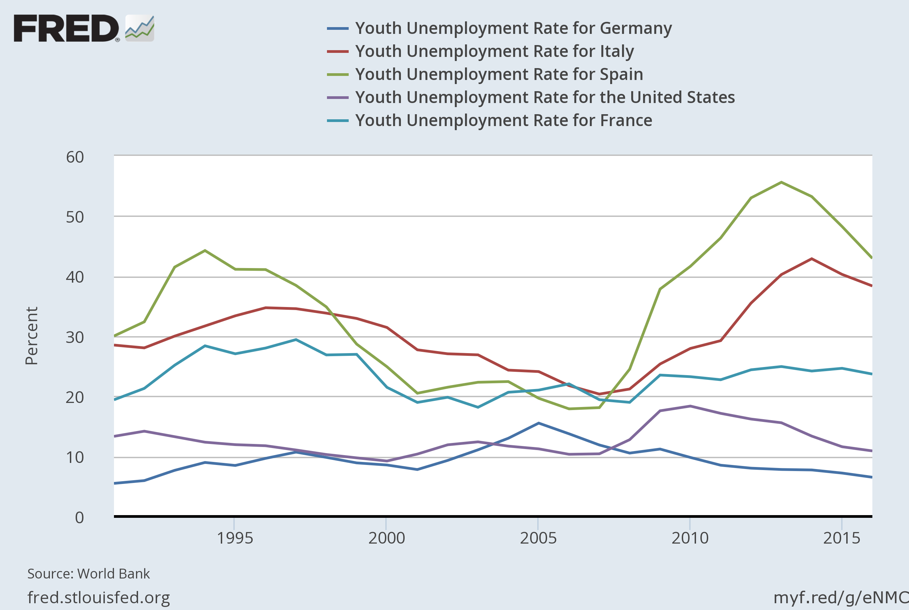
Labor Market “Protections” & Young Workers

Slide 15
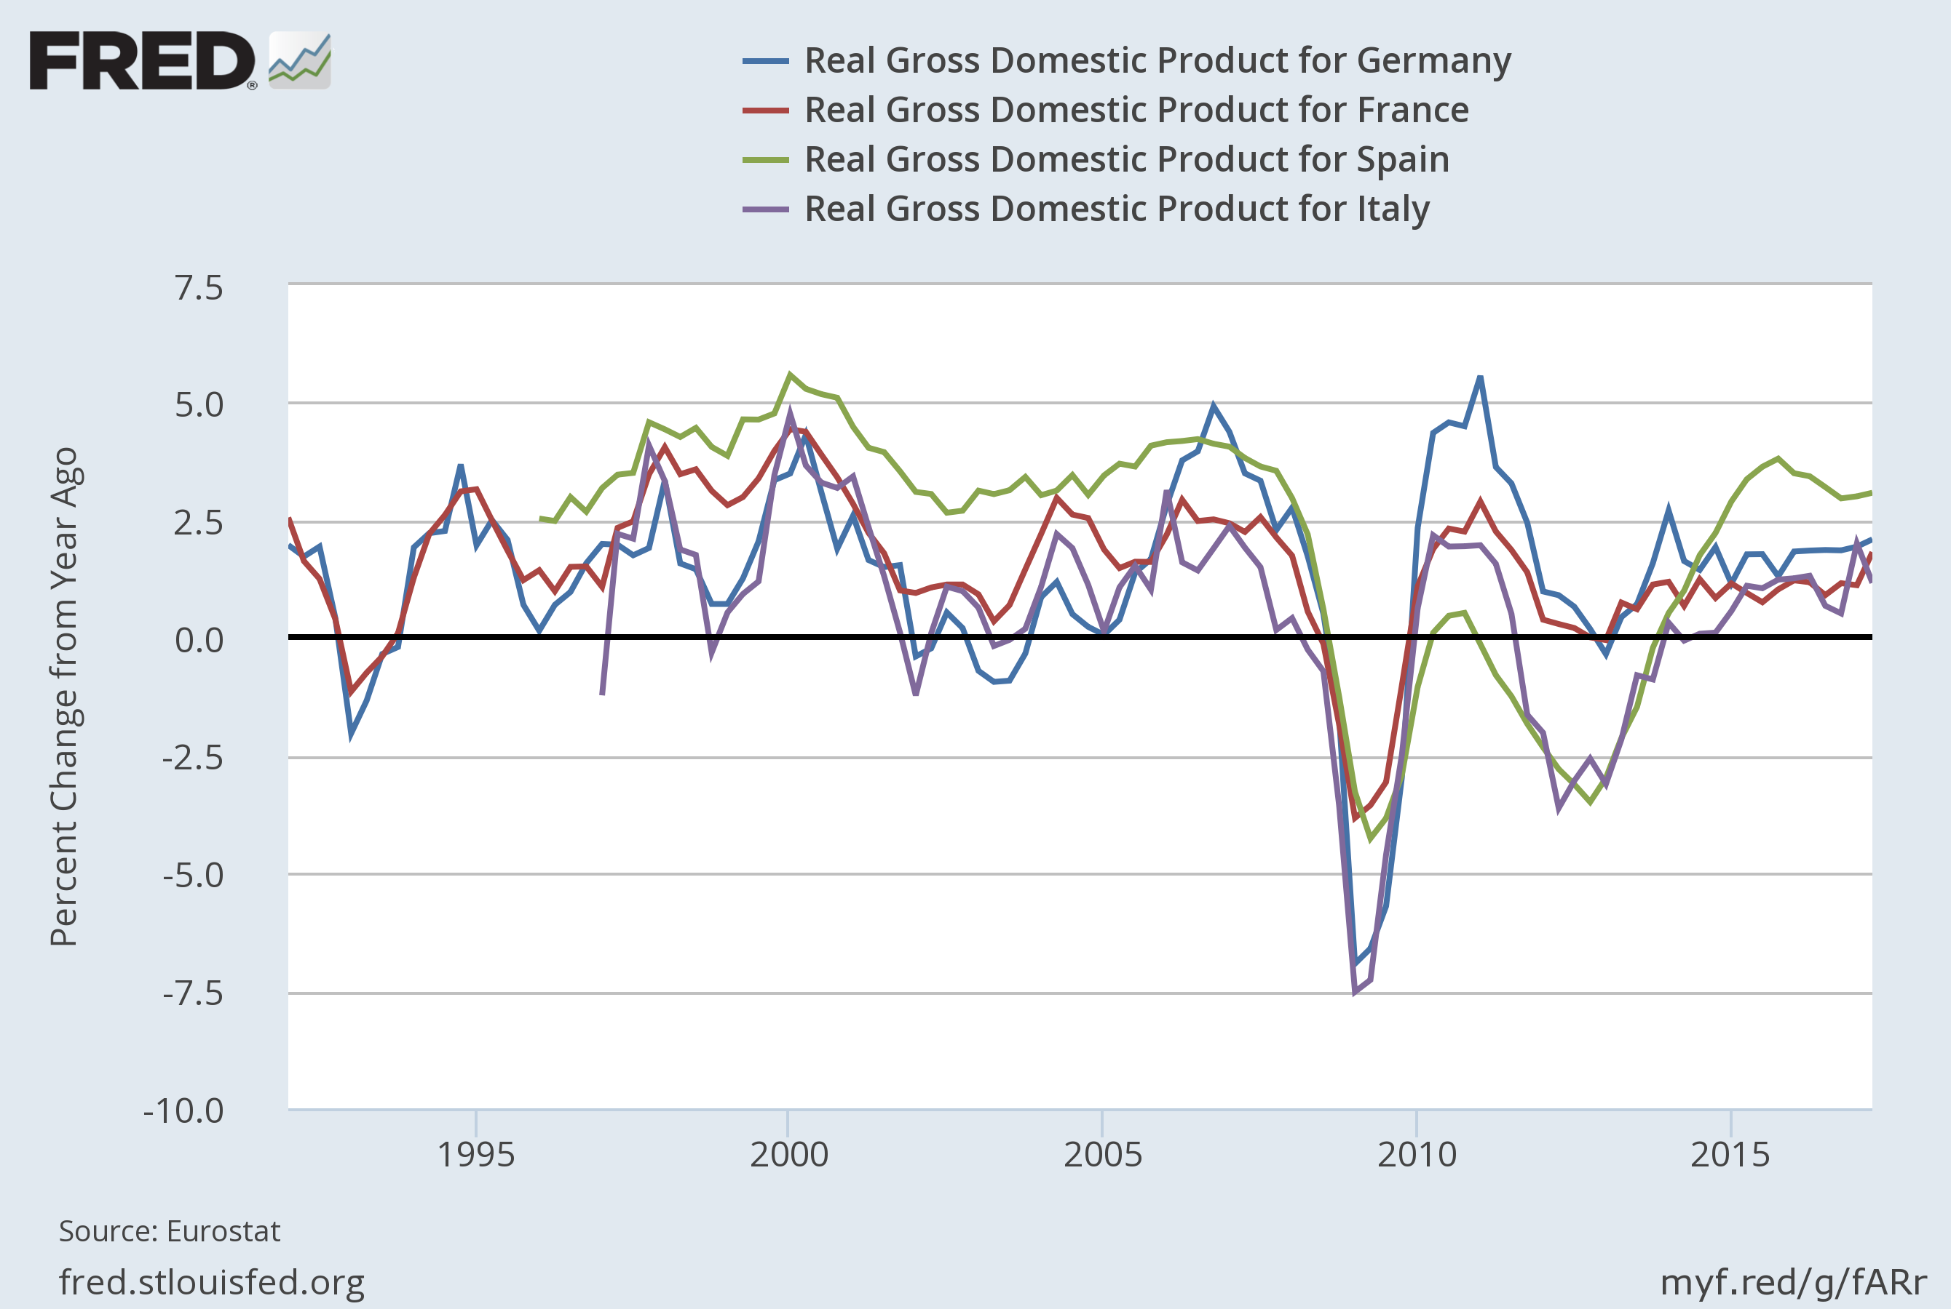
Econ Crisis in EU: Great Recession(s)

Slide 16
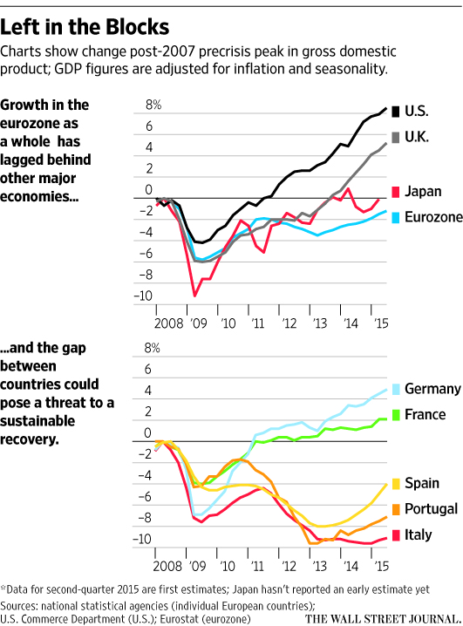
Post Recession Problems

Slide 17
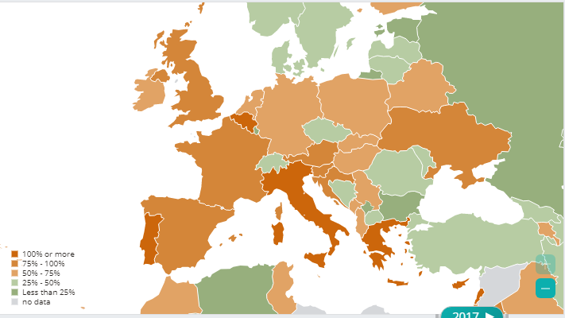
EU Debt Problem: Govt Debt as % of GDP

Slide 18
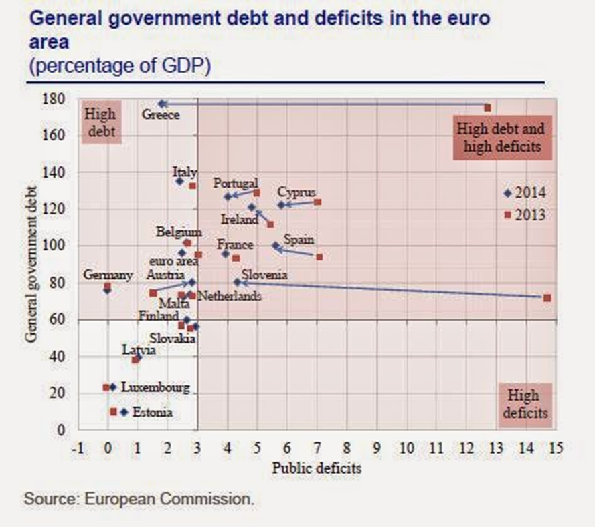
EU Debt & Deficit Problems

Slide 19
Evolving Market Views of EU

Slide 20
Evolving Market Views of EU

Slide 21
Evolving Market Views of EU

Slide 22
EU Debt Economics (also U.S. & Japan)
Theory & Debt Sustainability
Short Run Government Spending Constraint
Tax Revenue (current & future) + Debt Borrowed >=
Debt Payments + Government Expenditure (current and future)
Long Run Constraint with NPG Condition (PV Debt Borrowed = 0)
Tax Revenue >= Debt Payments + Govt Expenditure
(current & future)

Slide 23
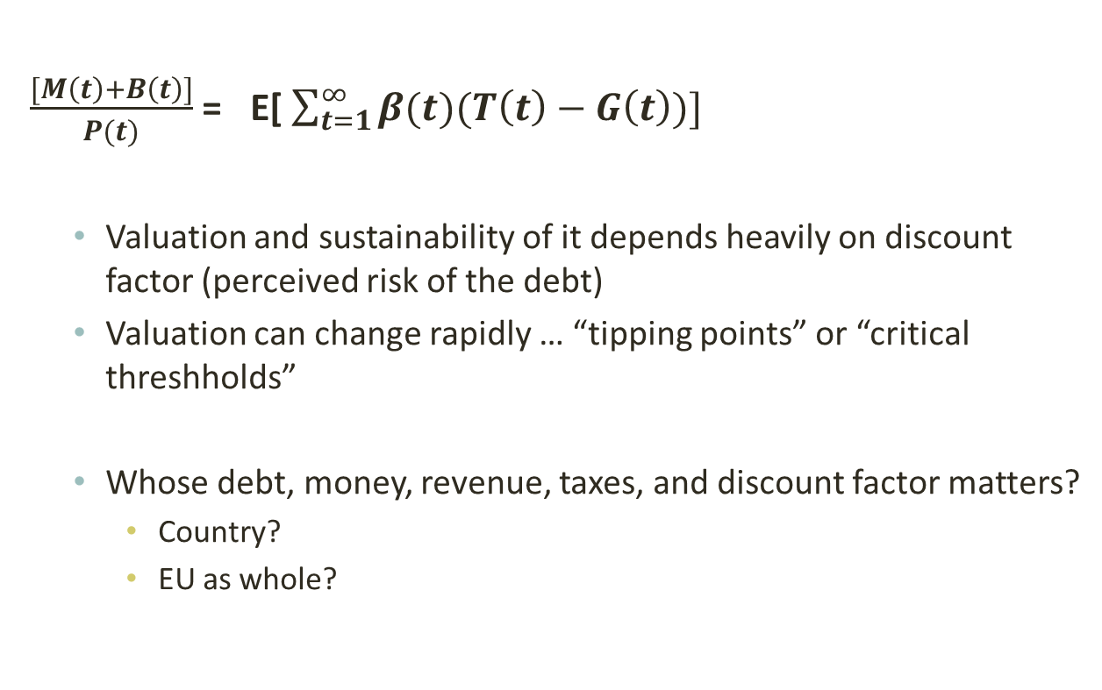
Market Valuation of Public Debt
$\frac{\begin{aligned} \\ \\ [M\left(t\right)+B\left(t\right)]\end{aligned}}{P(t)}$ = E[ $\sum_{t=1}^{∞}{β(t)(T\left(t\right)−G\left(t\right))]}$
  Valuation and sustainability of it depends heavily on discount factor (perceived risk of the debt)
  Valuation can change rapidly … “tipping points” or “critical threshholds”
  Whose debt, money, revenue, taxes, and discount factor matters?
    Country?
    EU as whole?

