Slide 1
Fluctuations in The
Value of Money
Inflation and Deflation

Slide 2
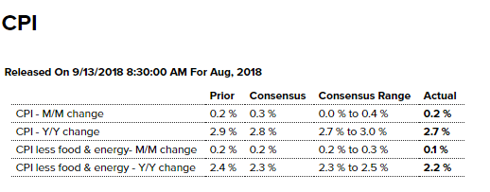
INFLATION
Inflation (on an annual basis) is the percent change in the average price level for the given period
  Basic Formula
  Annual v Annualized
  Standard v Core

Slide 3
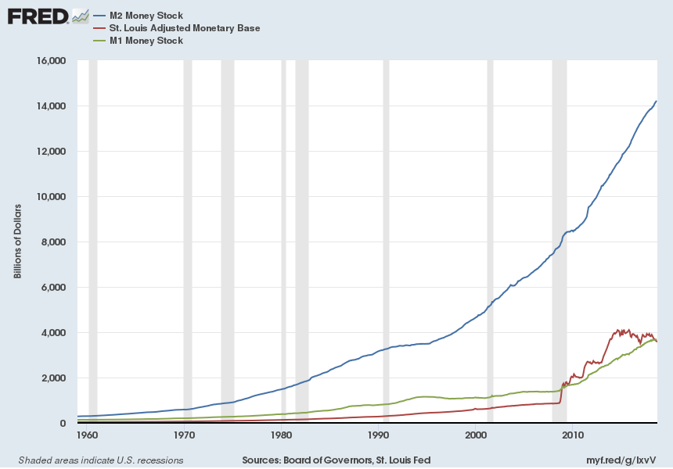
Defining Money: Monetary Base & M2

Slide 4
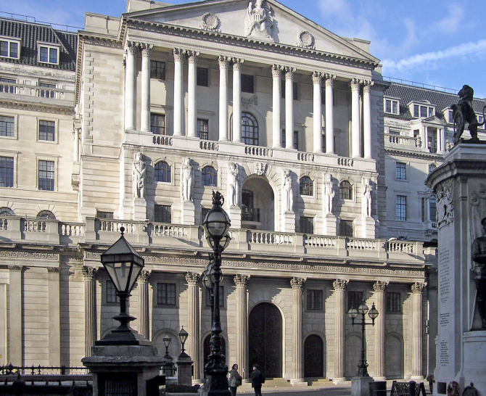







Central Banks & Monetary System

Slide 5
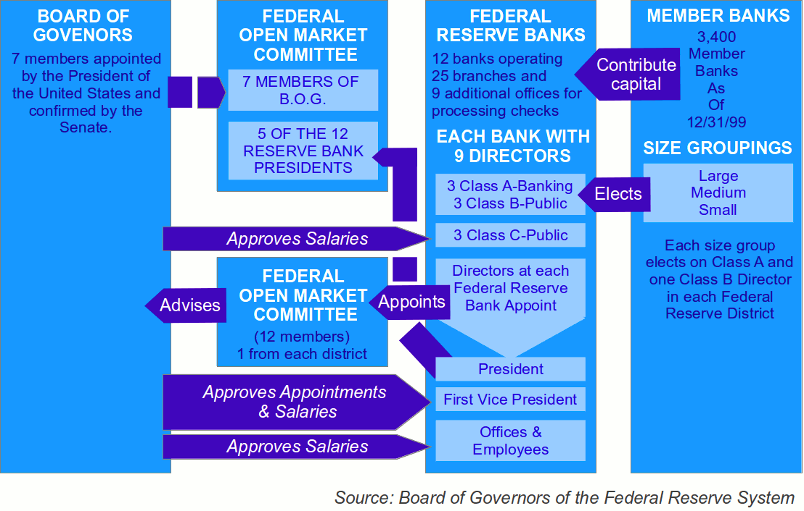
Fed Structure

Slide 6
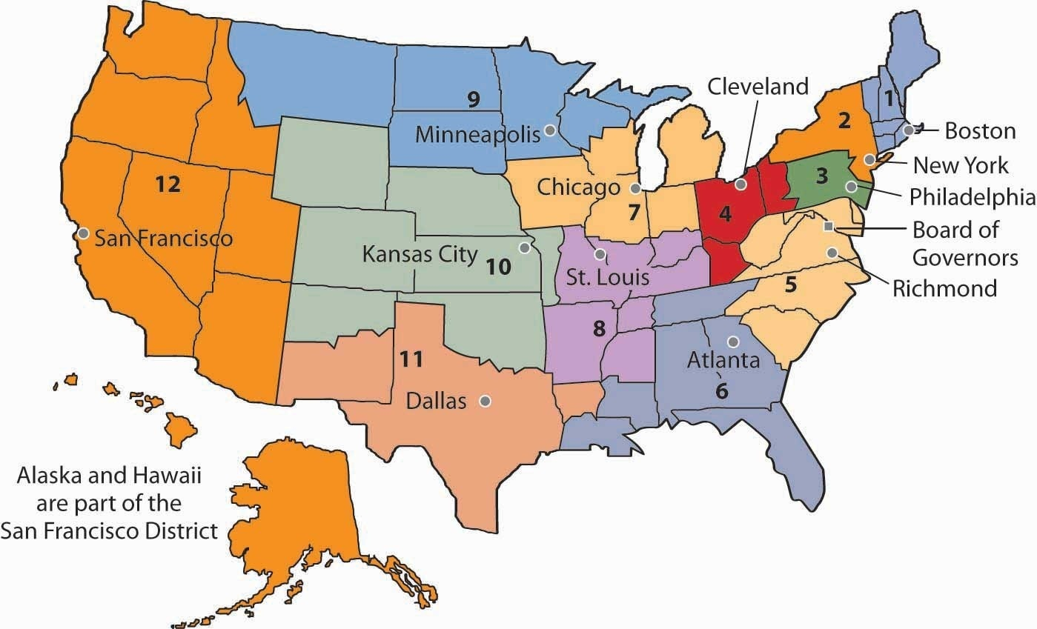
Map of Federal Reserve System
Geographic dispersion of political power and service

Slide 7
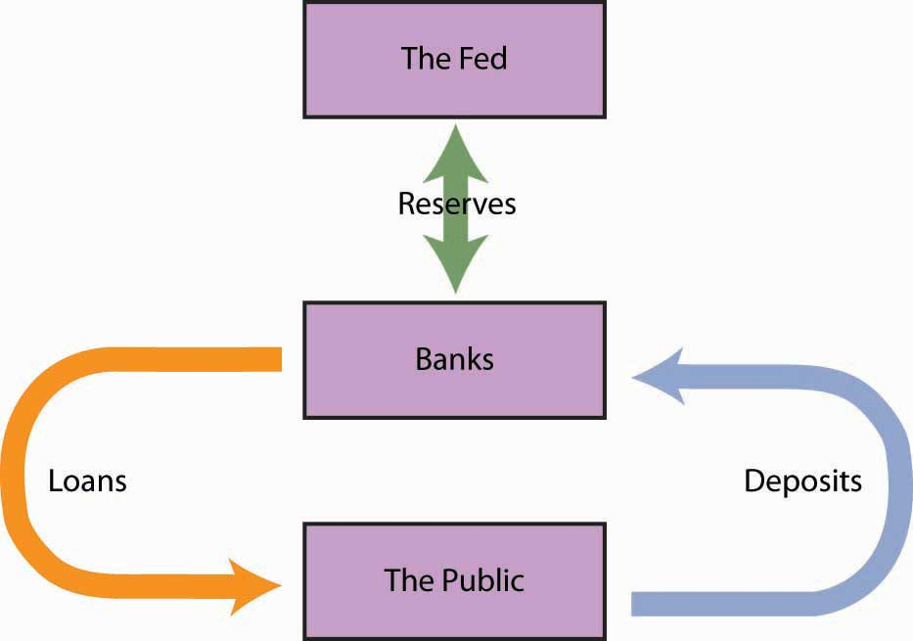
The Fed, Money Creation, & Money Multiplier
“Open Market Operations”
1. Fed Buys $1 M Bonds,
Increases Monetary Base
(Bank Reserves)
2. Banks Lend $1M
of New Reserves
3. Public Deposits
$800K + Takes $200K Cash
4. Banks Lend $700K
Of new deposits
5. Public Deposits …

Slide 8
Mechanics of Open Market Operations
From NY Federal Reserve Website:
  Primary Dealers
  “Primary dealers are trading counterparties of the New York Fed in its implementation of monetary policy. They are also expected to make markets for the New York Fed on behalf of its official account holders as needed, and to bid on a pro-rata basis in all Treasury auctions at reasonably competitive prices.”
  Current Primary Dealers (“Investment Banks”)
  Bank of Nova Scotia BMO Capital BNP Paribas Barclays Capital
  Credit Suisse Citigroup Global Daiwa Capital Deutsche Bank
  Goldman Sachs HSBC Securities Jeffries JP Morgan Merrill Lynch
  Mizuho Securities Morgan Stanley Nomura Securities RBC Capital
  RBS Securities Societe General TD Securities UBS Securities Wells Fargo

Slide 9
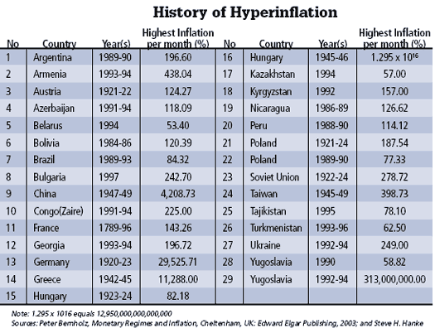

Slide 10
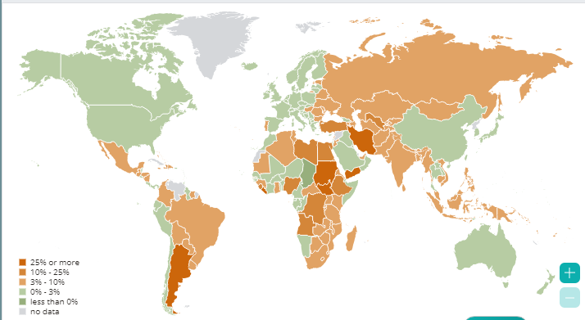
Current High Inflations
47%
> 1 mil %
64%
99%
40%

Slide 11
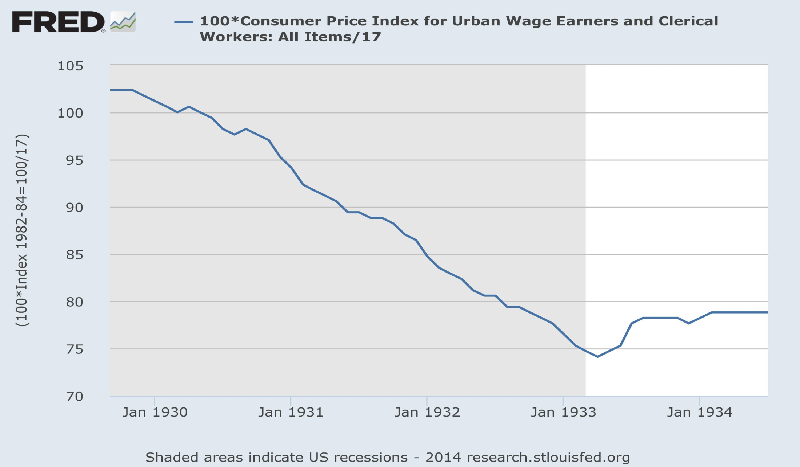
Deflation in Great Depression

Slide 12
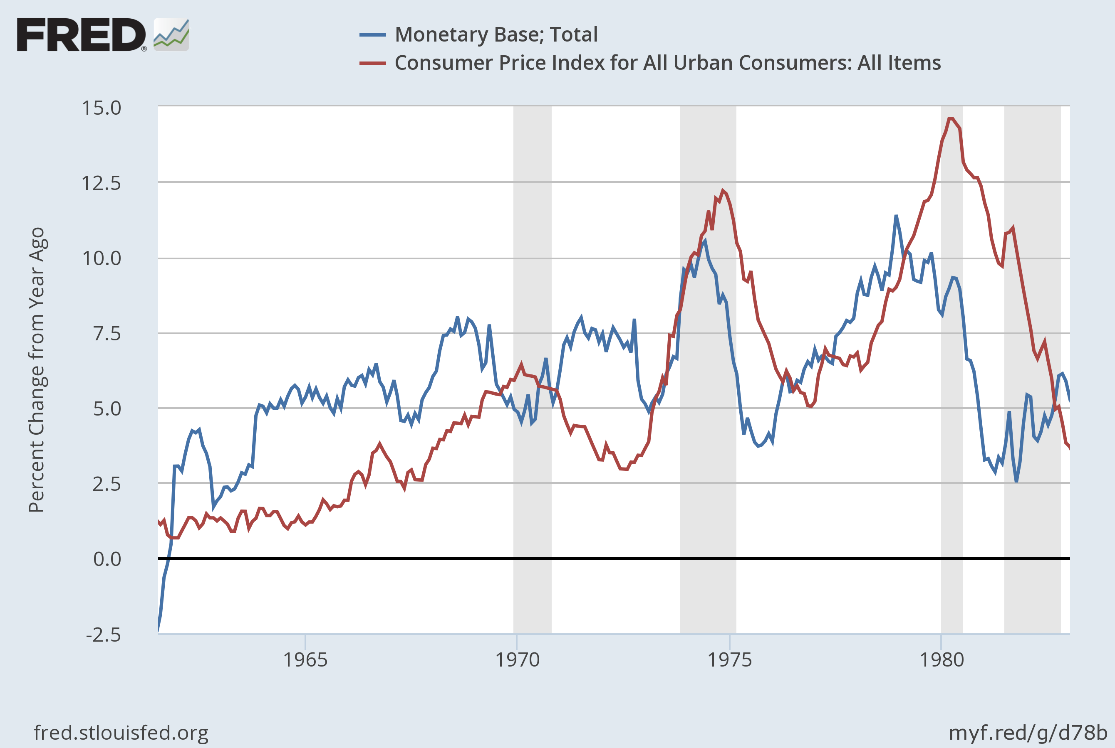
U.S. “Great Inflation” of the 1960s and 1970s
& Growth in Quantity of Money

Slide 13
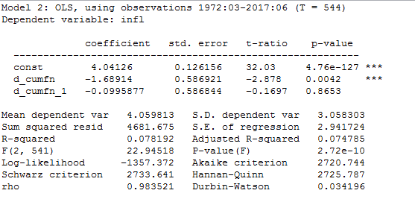
Non-monetary, Slack” Theories of Inflation
Inflation = b0 + b1*d(capacity utilization)

Slide 14
Slack: Inflation & Unemployment
(Phillips Curve)

Slide 15
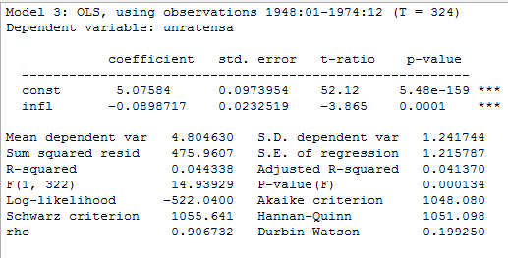
“Slack” & Inflation:
Phillips Curve 1948-1974

Slide 16
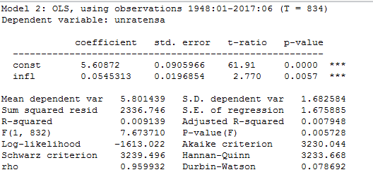
“Slack” & Inflation:
Phillips Curve 1948-2017

Slide 17
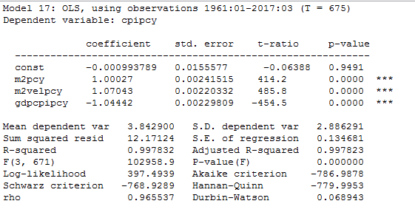
Re-Estimating: dln(P) = b0 + b1*dln(M) + b2*dln(V) – b3*dln(y)
Measurement Methods Matter:
Mixing CPI (inflation) with GDP-deflator for real GDP

Slide 18
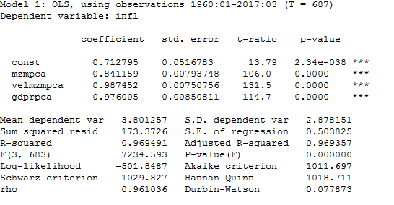
Estimating Inflation from Equation of Exchange
%d(P) = b0 + b1*%d(M) + b2*%d(V) – b3*%d(y)
Note: Using annual percent change & NSA for cpi & mzm

Slide 19
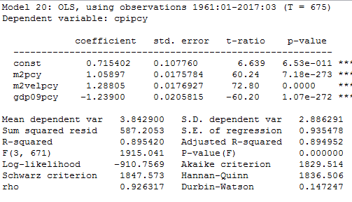
Re-Estimating: dln(P) = b0 + b1*dln(M) + b2*dln(V) – b3*dln(y)
Measurement Methods Matter:
Mixing CPI (inflation) with GDP-deflator for real GDP

Slide 20
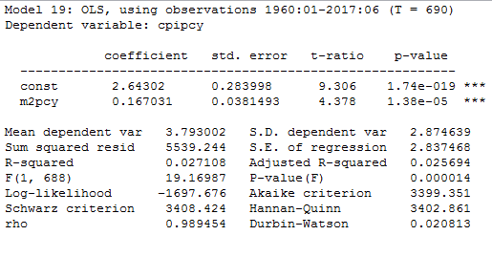
Simple “Quantity Theory”
%d(P)= b0 +b1*%d(M): monthly data using M2

Slide 21
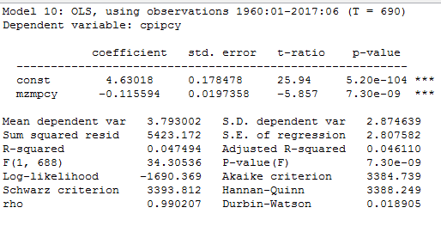
Simple “Quantity Theory”
%d(P)= b0 +b1*%d(M): monthly data using MZM

Slide 22
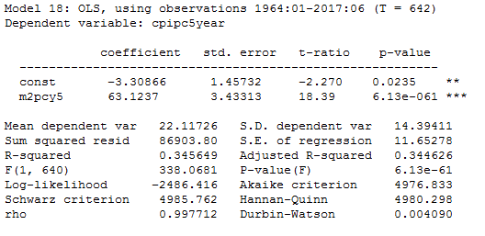
Simple “Quantity Theory” dln(P)= b0 +b1*dln(M): 5-year averages w/M2

Slide 23
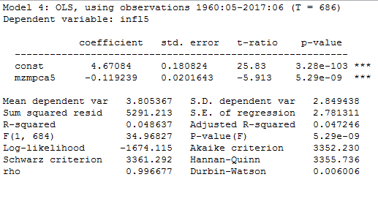
Simple “Quantity Theory” dln(P)= b0 +b1*dln(M): 5-year averages w/MZM

Slide 24
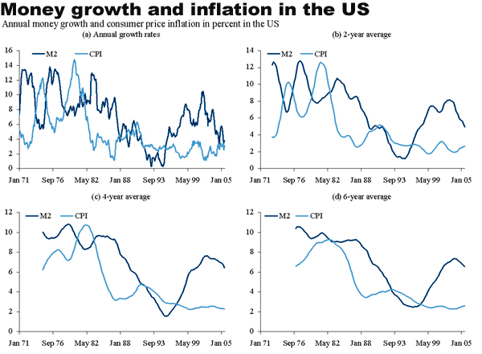
Quantity Theory (dlnP=b0+b1*dlnM)
At 1, 2, 4, 6 Year Averages (Cleveland Fed)

Slide 25
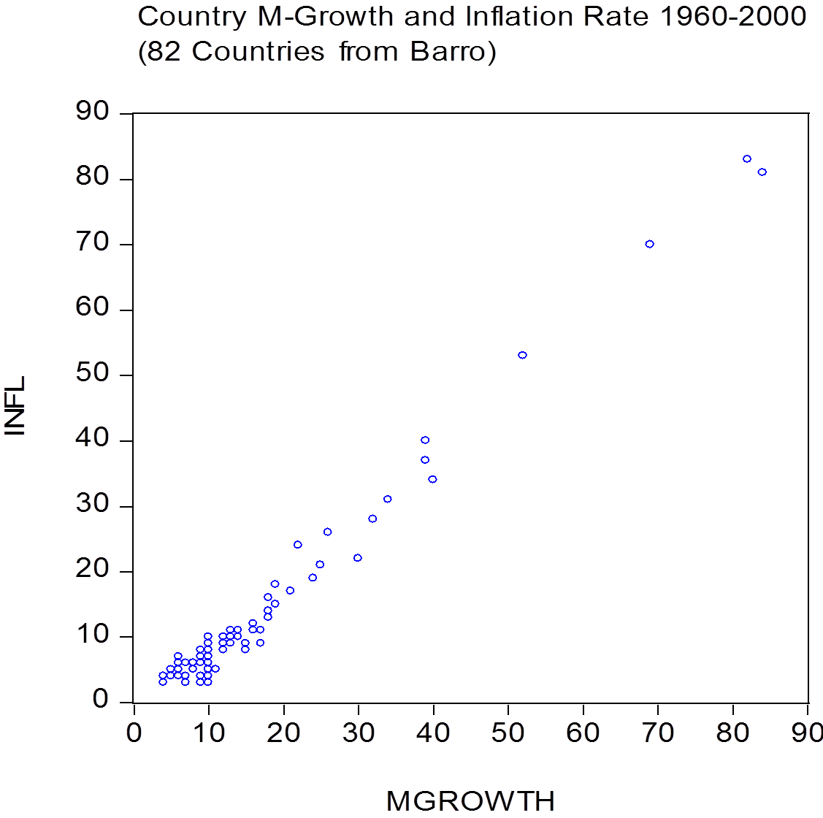
Simple Quantity Theory: dlnP = dlnM
Using 40-year Cross-Country Data

Slide 26
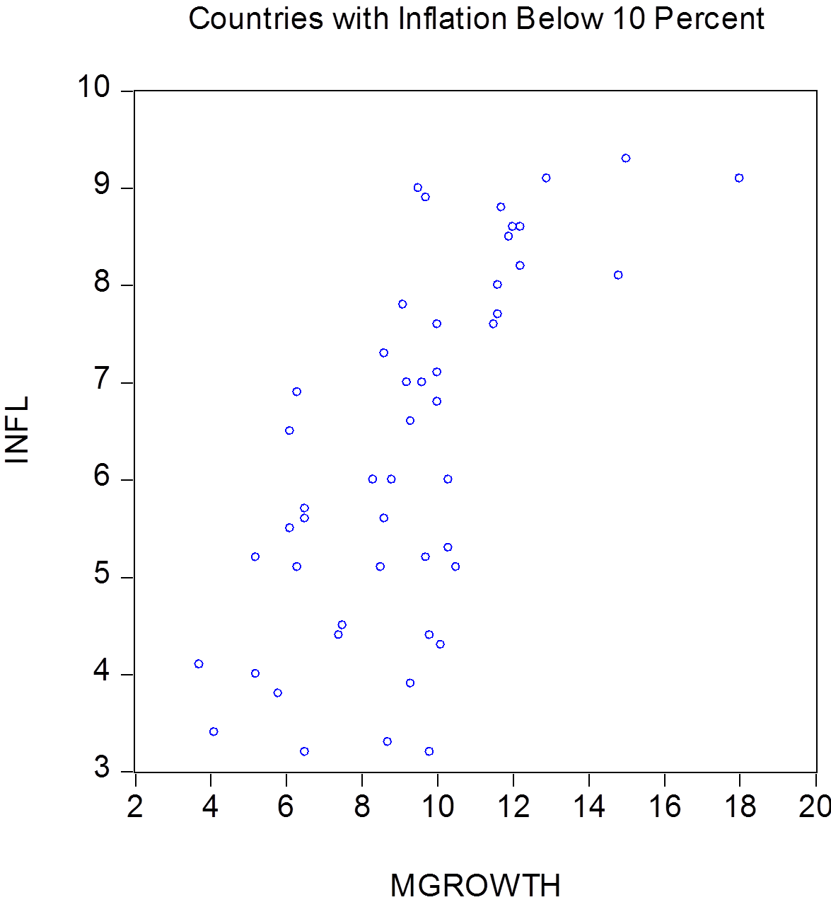
Quantity Theory: 40 Year Averages
Using Countries Below 10% Inflation

Slide 27
Simple Quantity Theory: dlnP = dlnM
Using 40-year Cross-Country Data
Why quantity theory so good here?

Slide 28
Quantity Theory Tests
At High and Low Money Growth Rates
Inflation | Data | money growth coefficient | R2 | N
> 10 percent long run | 1960-2000 Average Barro | 1.04 | 0.99 | 26
> 10 percent in year | 1960-2000 Average Barro | 1.03ª | 0.99 | 26
> 10 percent in year | 1960-2013 Annual OECD | 0.73 | 0.77 | 151
> 10 percent in year | 1960-2013 Annual OECD | 0.82^{b} | 0.83 | 130
< 10 percent long run | 1960-2000 Average Barro | 0.45 | 0.48 | 50
< 10 percent long run | 1960-2000 Average Barro | 0.64ª | 0.65 | 50
< 10 percent in year | 1960-2013 Annual OECD | 0.05 | 0.05 | 787
< 10 percent in year | 1960-2013 Annual OECD | 0.11^{b} | 0.15 | 688

Slide 29
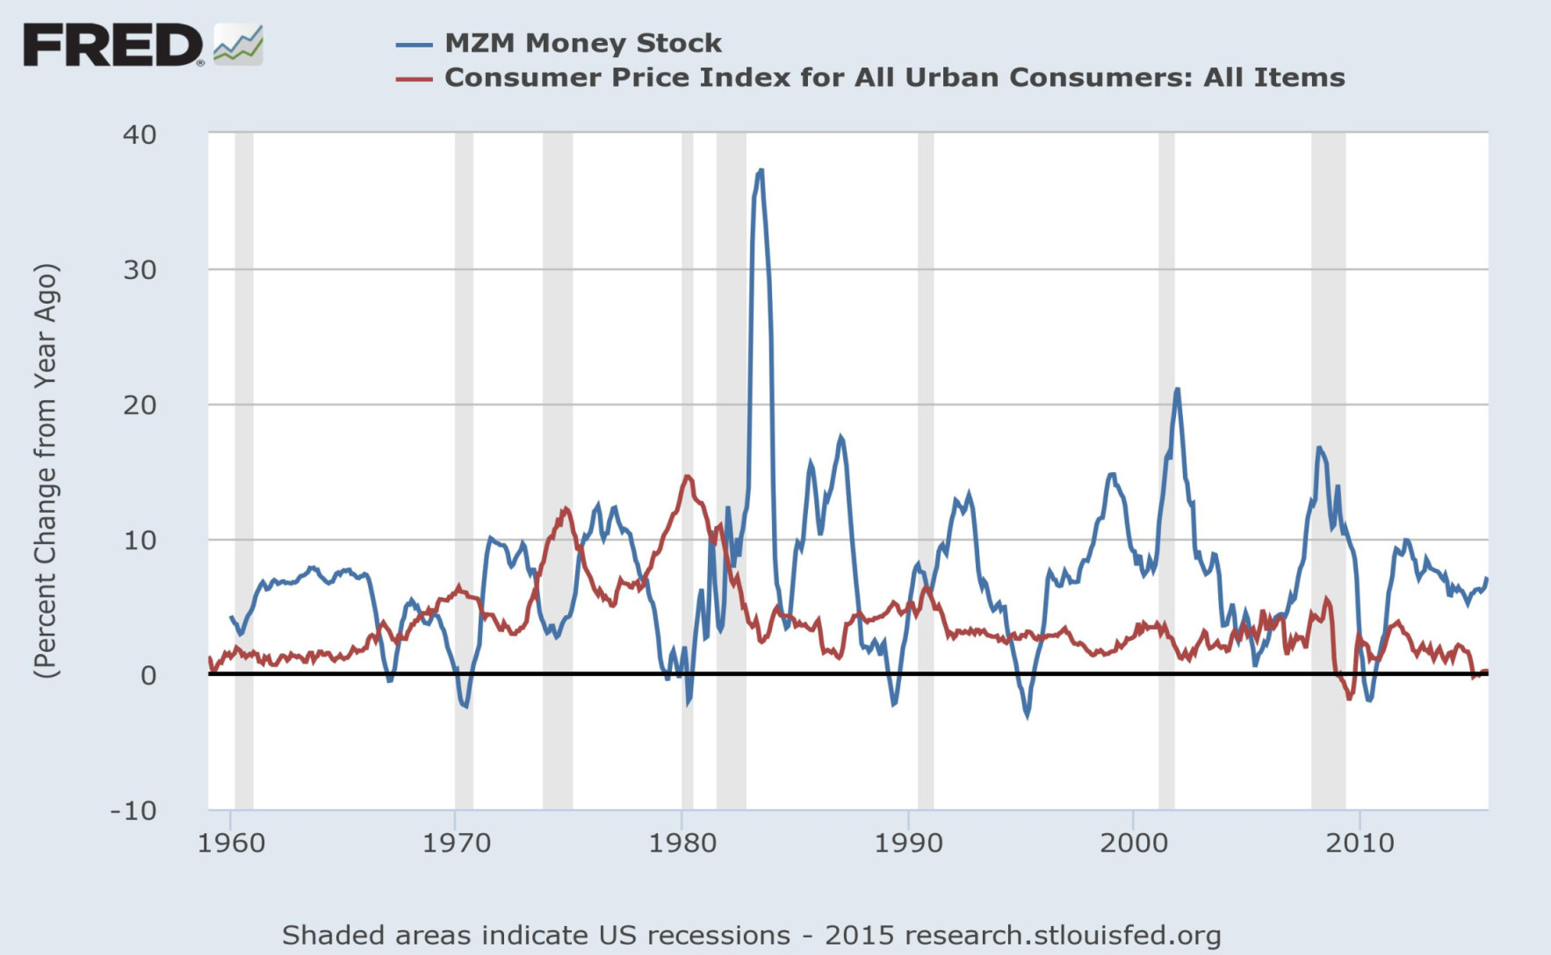
Money Supply & Inflation

Slide 30
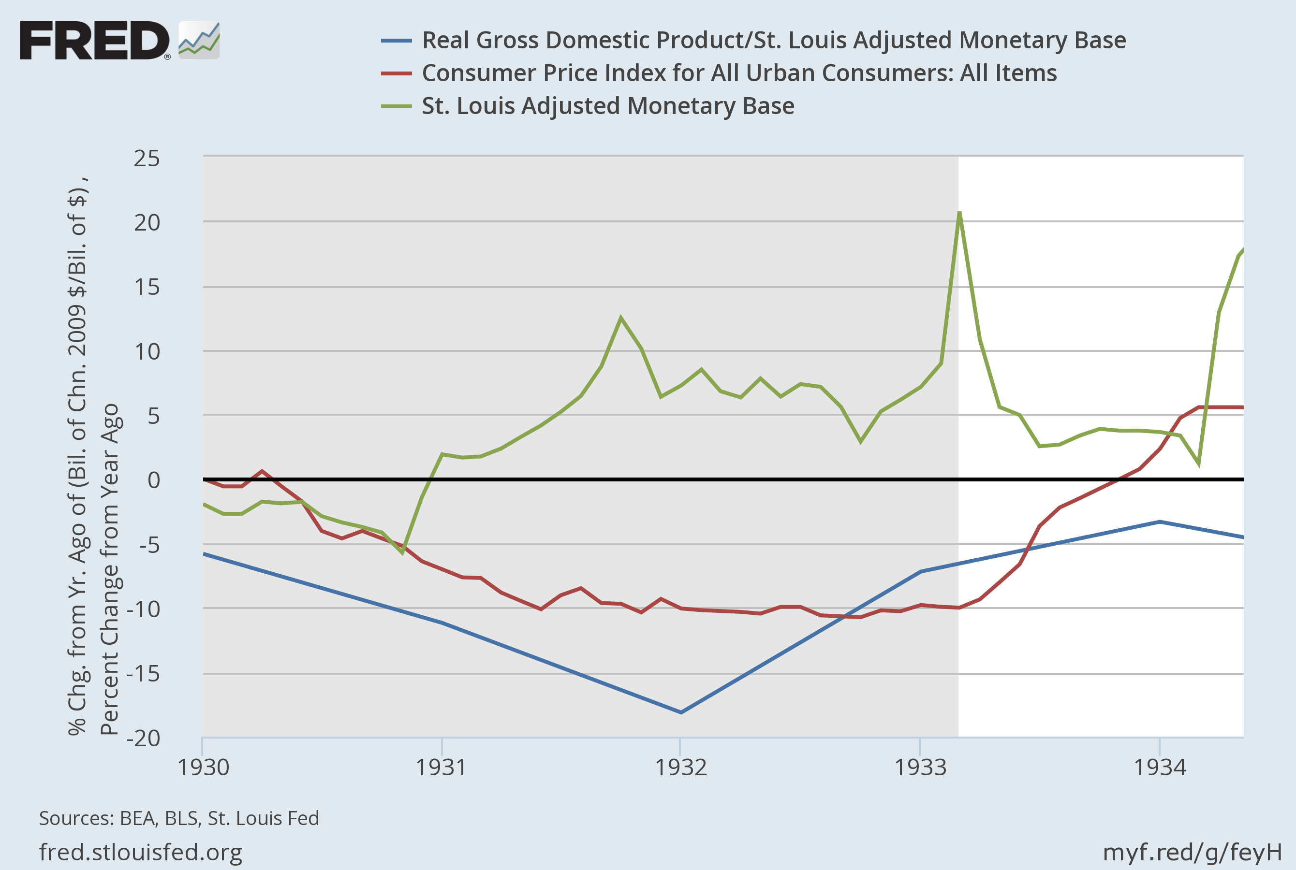
Great Depression Deflation:
Monetary Base
Monetary Base
CPI
Velocity of Money

Slide 31
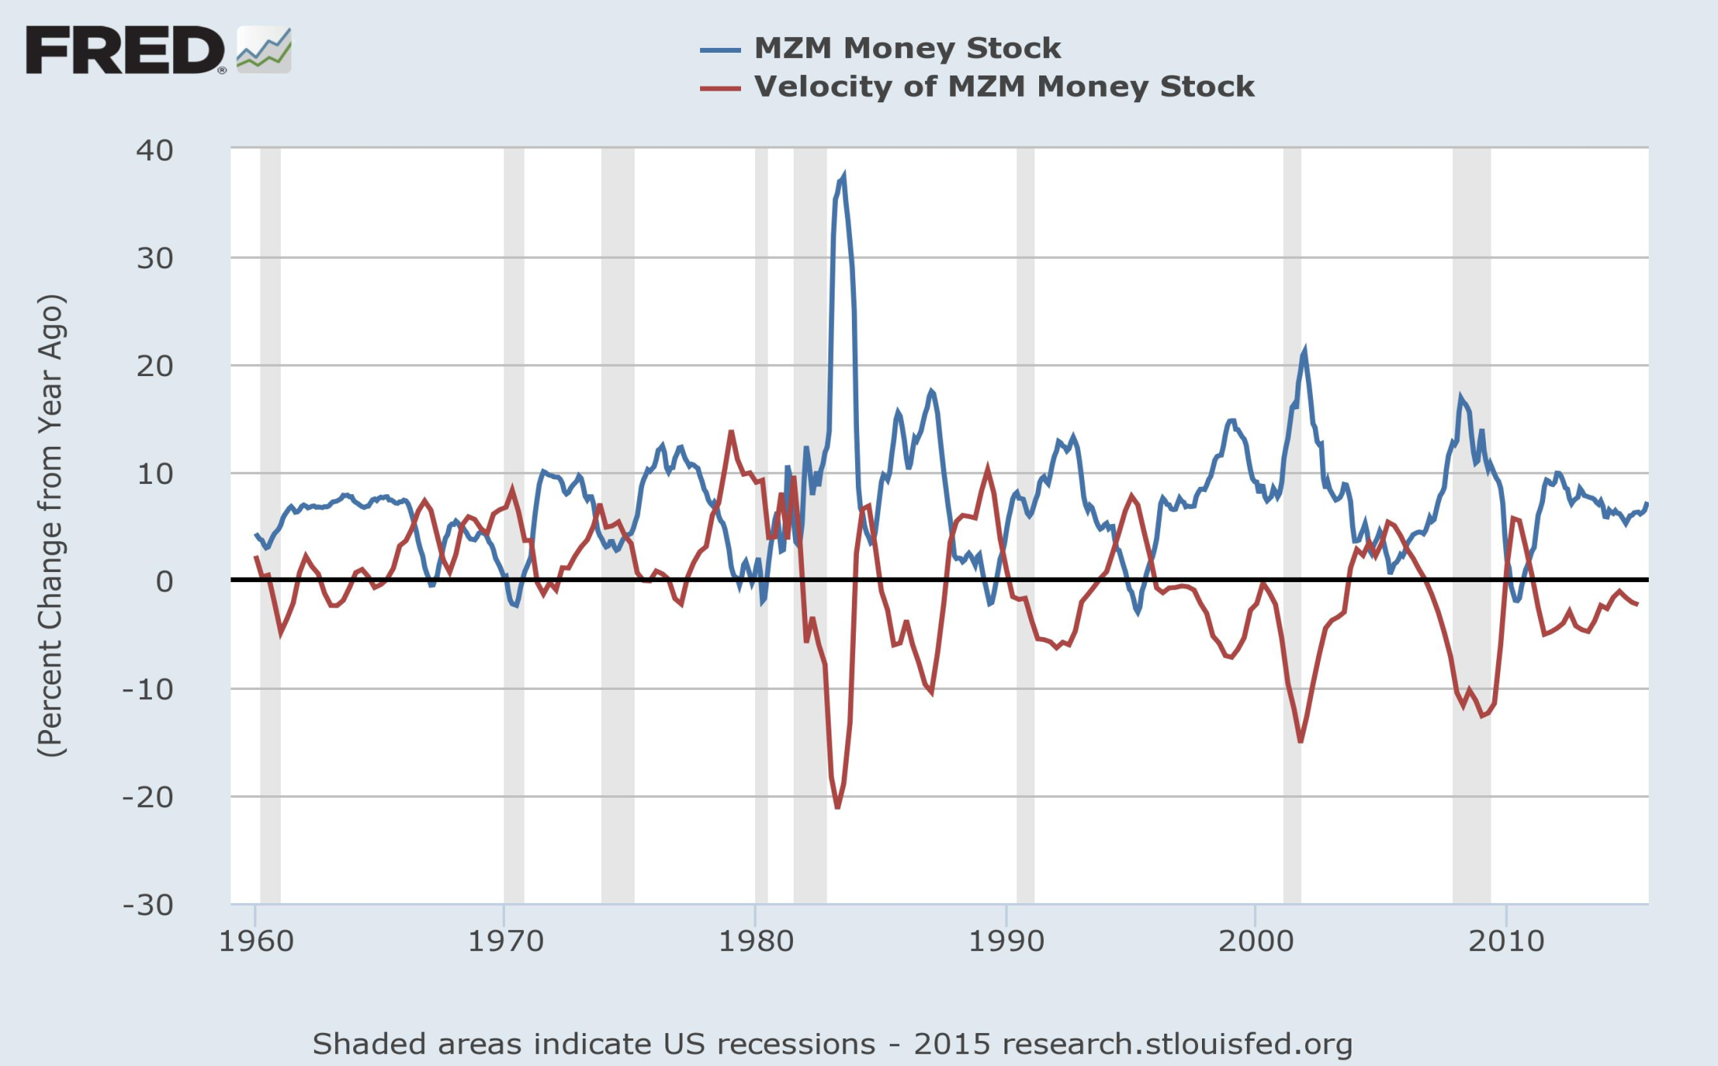
Money & Velocity

Slide 32
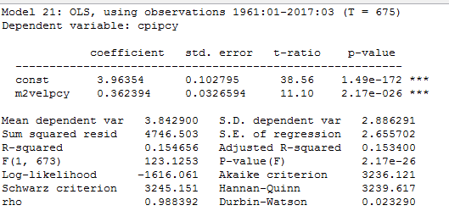
Inflation & Velocity

Slide 33
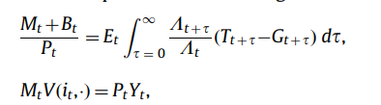
What’s Behind Velocity Changes?
Assessments of Currency Valuation Risk
  Banking Deposits (Great Depression)
  Govt “Balance Sheet”

Slide 34
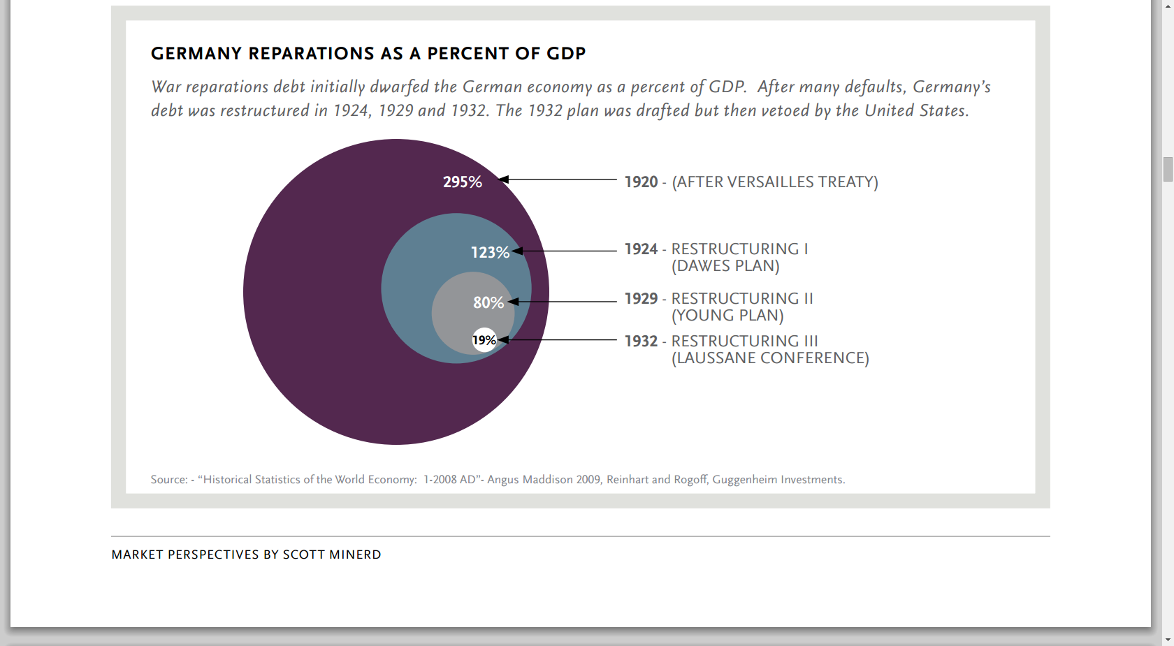
Why Would Any Country Create Money at Enormous Rates?
Connections Between Gov’t Debt & Money

Slide 35
Simple “Fiscal Theory” dln(P)= b0 + b1*dlnM + b2*dlnB

Slide 36
M+B for U.S.

Slide 37
M+B Growth in 1970s

Slide 38
U.S. Implied Surplus To Offset M+B
(Beckworth & Goff)

Slide 39
