Slide 1
Interest Rates
Influences & Issues

Slide 2
Where Do Rates Come From?
In Prescott-type model, β^{t} discounts value of future consumption for a household
β^{t} arises from two fundamental sources where
  Value of consumption now versus future:
  Risk aversion
Interest Rates reflect these factors aggregated over entire economy
  Credit Markets arise from differences in risk aversion/marginal utility
  NLSY Study of Individuals

Slide 3
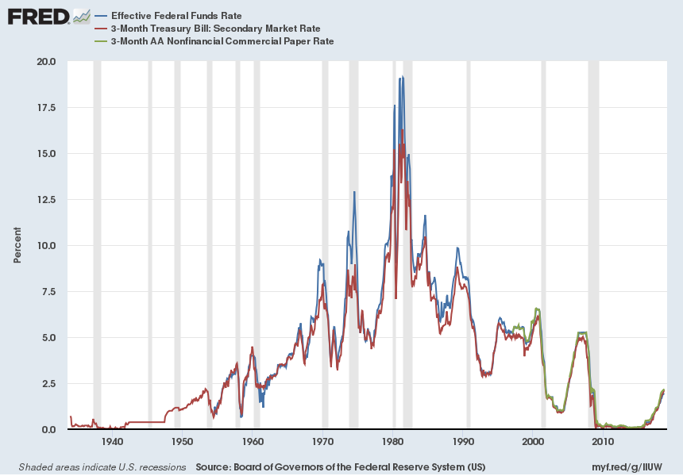
Short Rates

Slide 4
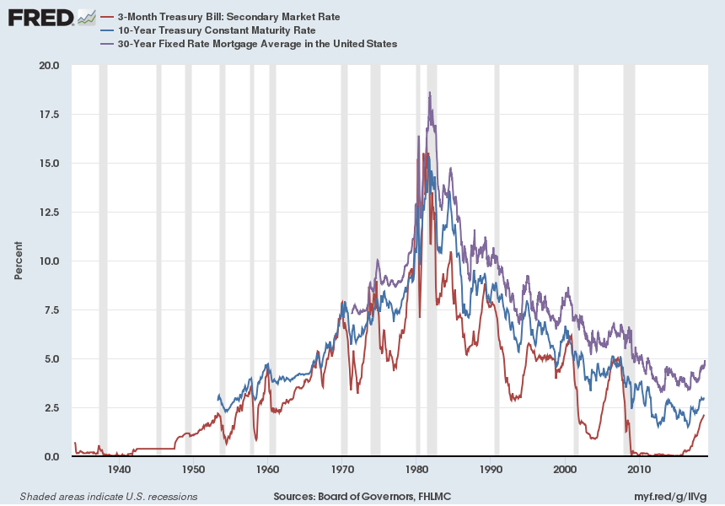
Long Rates

Slide 5
Rate Correlations:
In Levels and Differences
Rates in Levels
Rates in Differences

Slide 6
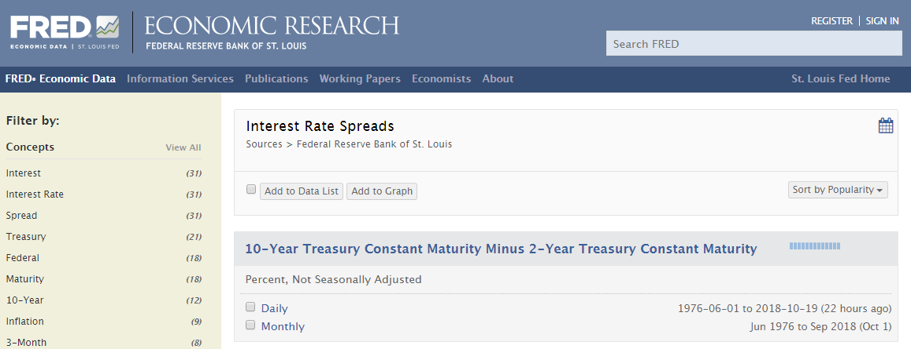
Info Embedded in
Interest Rate Spreads

Slide 7
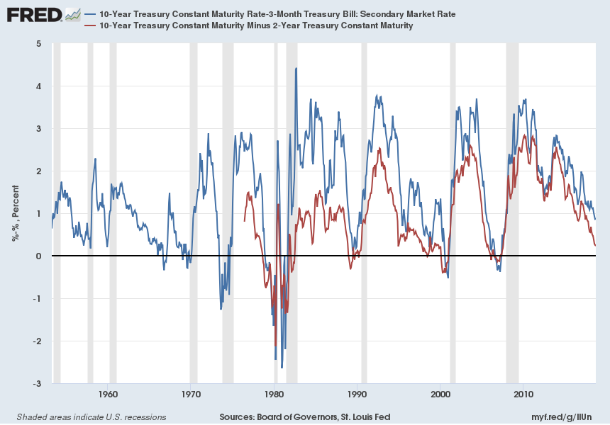
Treasuries: 10year – 3month
10year – 2year

Slide 8
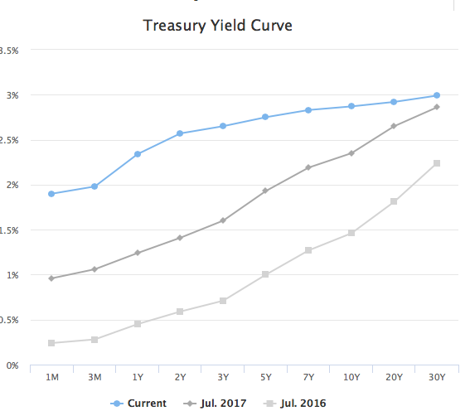
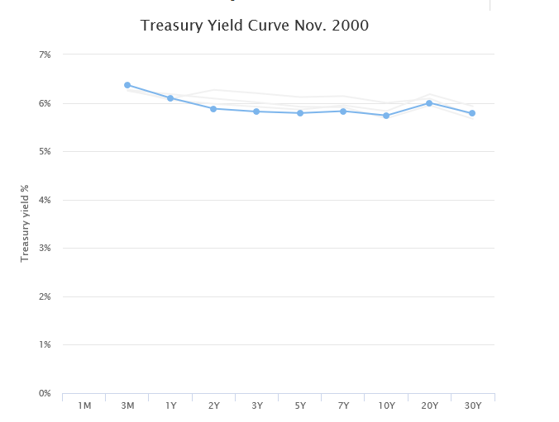
Combined Spreads: Treasury Yield Curve

Slide 9
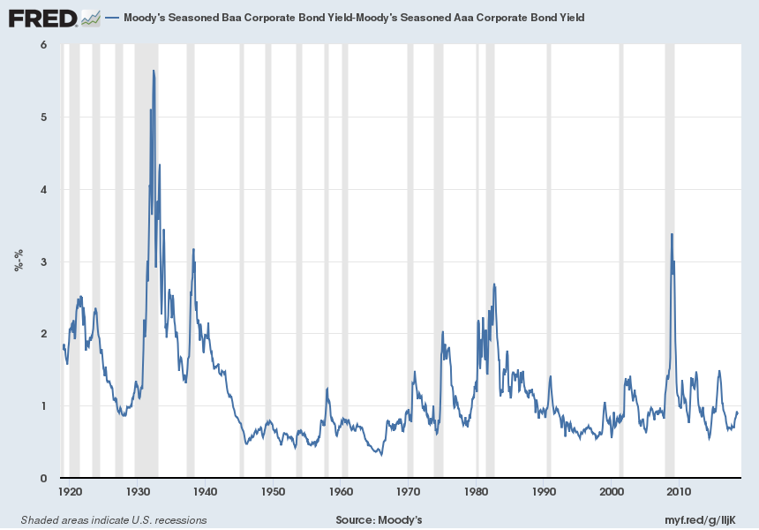
Corporate Bonds:
Baa Rate – Aaa Rate

Slide 10
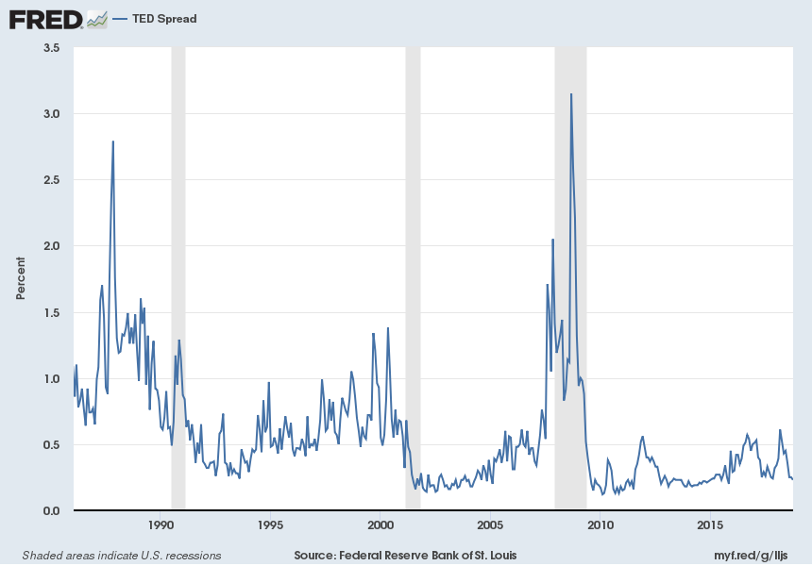
TED Spread
3month LIBOR – 3month Treasury

Slide 11
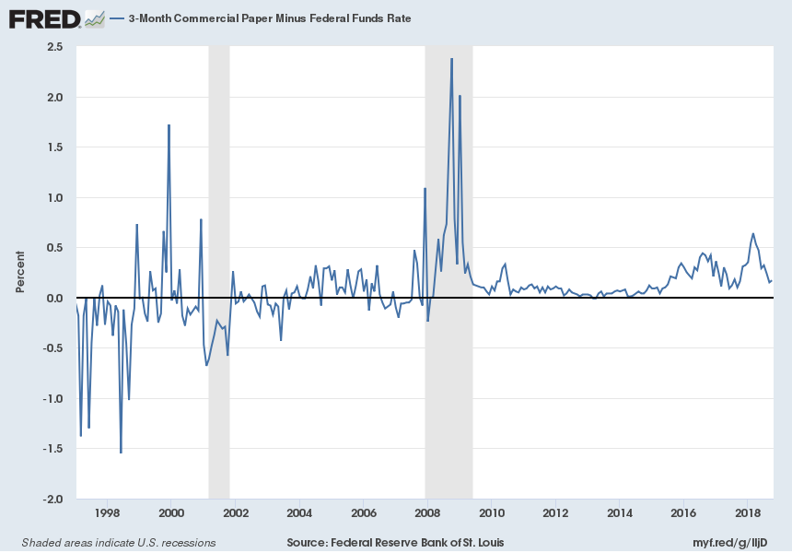
CPR – Fed Funds Rate

Slide 12
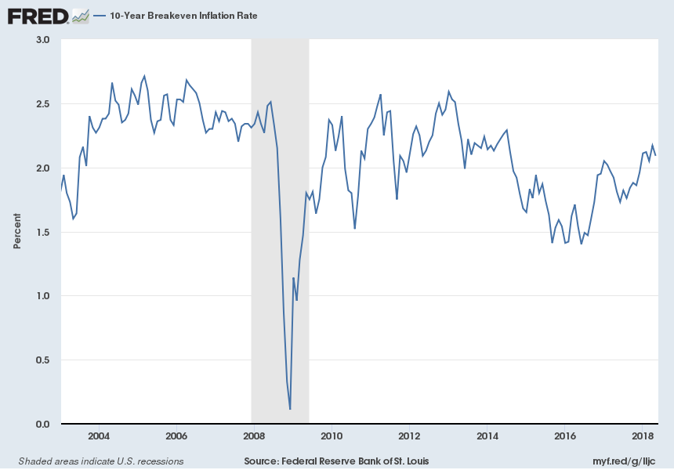
Treasuries: 10year Nominal – 10year Real (TIPS)

Slide 13
Fed Actions Through
Fisher Equation Lens
Fisher Equation:
  Nominal Rate (R) = real rate (r) + Expected Inflation (π^{e})

Slide 14
Fed Actions Through
Fisher Equation Lens
Fisher Equation:
  Nominal Rate (R) = real rate (r) + Expected Inflation (π^{e})
Fed Through Lens of Fisher Equation
  Expected Inflation
    Control Over Monetary Base
      Supply of money
    Other Influences?
  Real Rates
    Control Over Monetary Base
      Supply of credit (loaned funds)
  Opposing Effects?
  See 1970s

Slide 15
Mechanics of Fed Increasing Money-Credit
Fed-FOMC
Inflation & Interest Targets
NY-Fed Trading Desk
Purchase (Sell) Treasury Securities
20+ Primary Securities Dealers
Deposit by Seller of Treasury
Reserves Bank X Increase
Firm A Borrows $10 mil;
Deposits $ million in Bank K
Firm B Borrows $8 mil.;
Deposits $7 mil. Bank T;
Firm C Borrows $1 mil. In Comm. Paper;
Reserves Bank Y Increase
Reserves Bank Z Increase

Slide 16
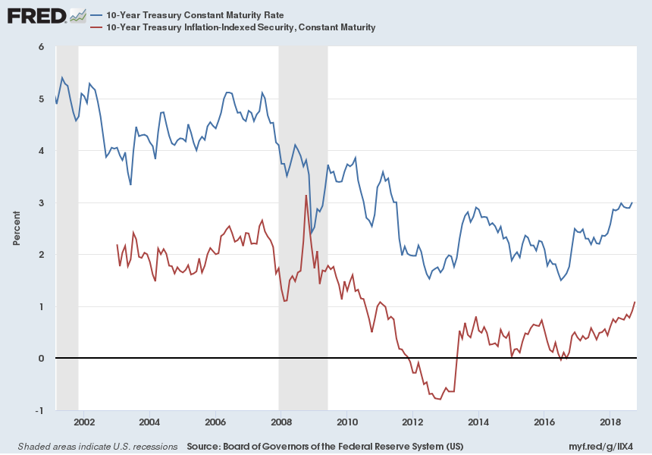
Measuring Real Rates and Expected Inflation

Slide 17
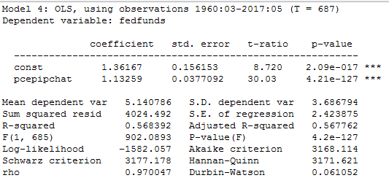
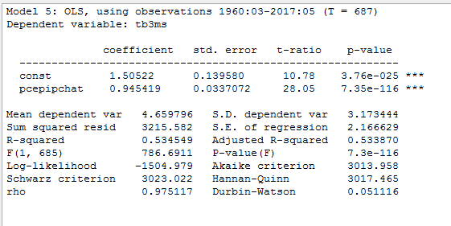
Rates & Expected Inflation
Note: Inflation is year to year; E(Infl) is AR2 model

Slide 18
Fed Actions Through
Taylor Rule Lens
Taylor Rule
  Background on Interest Rate Targeting
  Taylor Rule:
  TFF = r* + g1(π – π^{T} ) + g2(ygrowth – ypotential)
    Mechanics: M-Base & Credit Supply (See Prior Chart)
    Conditions necessary for Taylor Rule to work
      Measurement of variables in rule
      Background assumptions
  Key Question:
    Does Fed push market rates or is it pushed by them?
    How much can Fed “lean against” market moves in rates?

Slide 19
Output Gap Measures

Slide 20
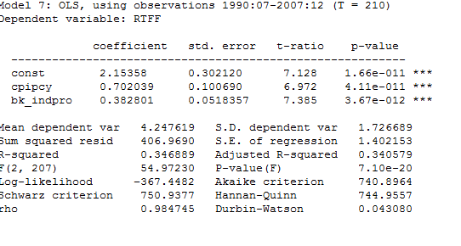
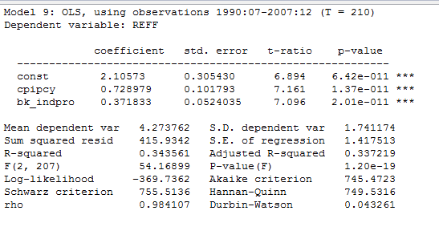
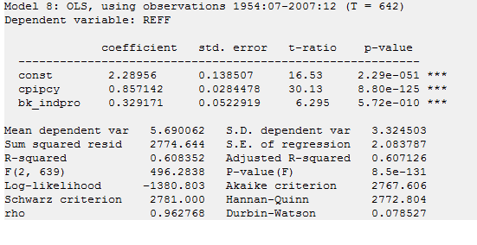
Has Fed Followed a Taylor-Type Rule?
Bk_indpro is cyclical fluctuations around
Variable trend using Baxter-King filter as
measure of output gap
If inflation target is constant, then
Results equivalent to using
(target infl – actual infl)

Slide 21
Fama on Fed Control of Rates:
Daily Data on Target FF (TF)
Figures 1a-1c: substantial daily spreads between TF and other short term rates (R = FF, CP, TB3, TB6, G5, G10)
Table 2 Regressions:
  dR = (R-TF) + R(t-i); very low R2 other than EFF
Table 3 Regressions:
dR = FF – TF + FF-CP …. Somewhat responsive
dR = CP – TF + CP-FF … Not responsive
Table 4 Regressions:
dTF = R(t-1) - TF(t-1); TF responsive esp since 94
Table 5 Regressions
dR(t+i) = TF(t-1) – R(t-1) when TF “event”
Some predictability for FF & CP, not TB3, TB6

Slide 22
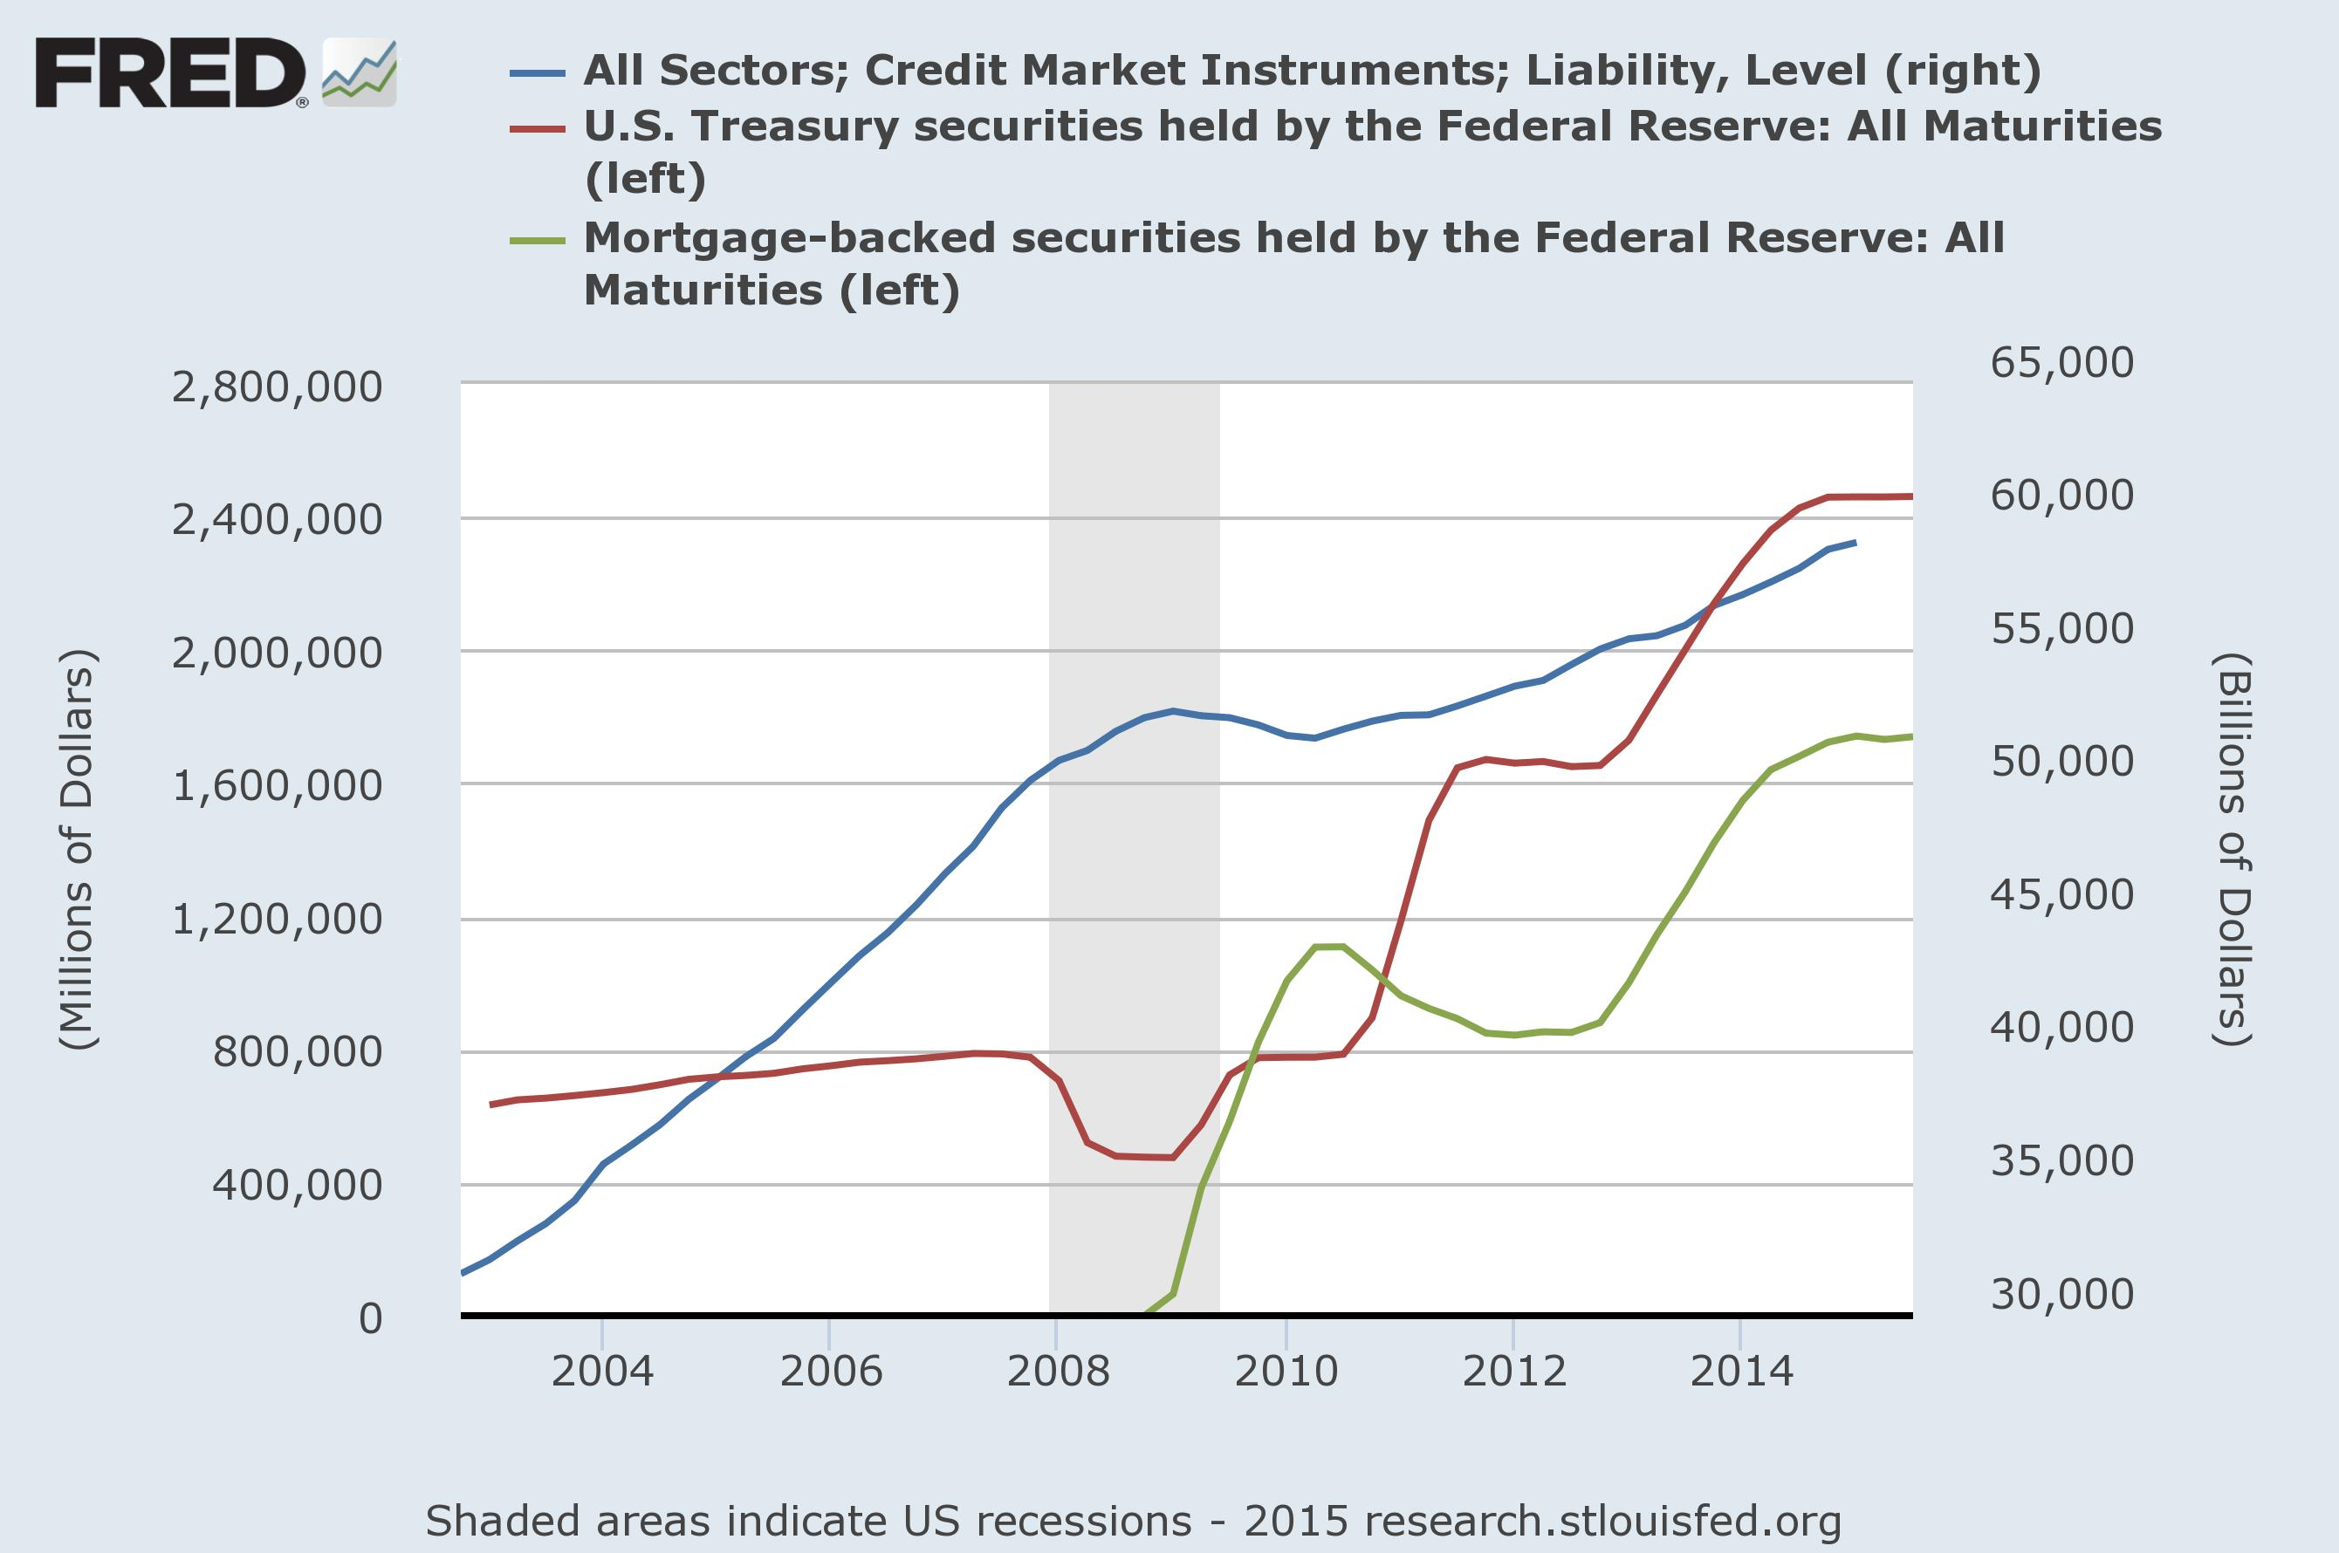
Limits to Fed Power?
Comparing Private & Public Credit

Slide 23
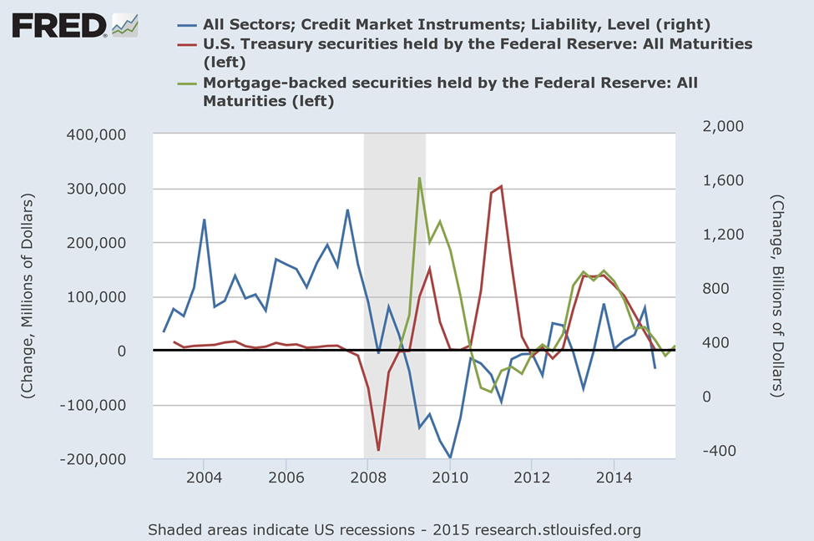
Credit Market Flows:
Comparing Fed v. Private Markets

Slide 24
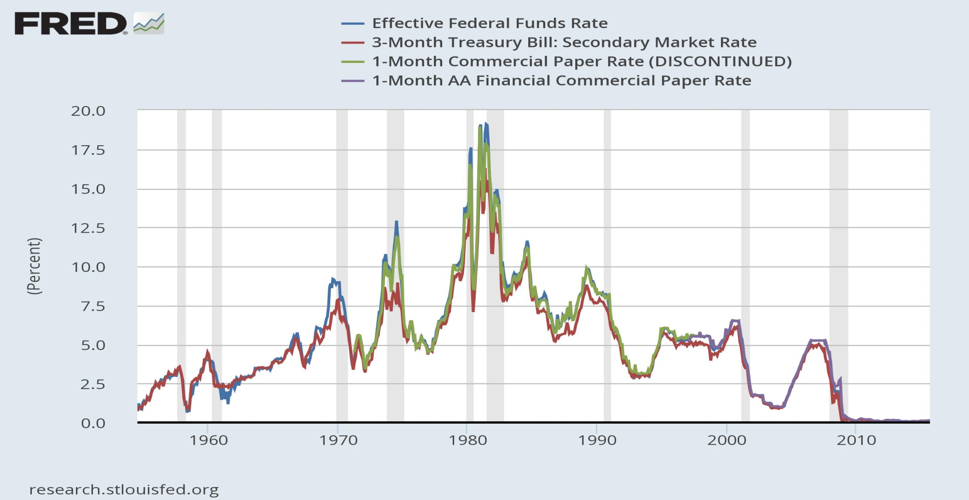
1970s and 2008 Illustrate Limits of
Fed Influence on Rates

Slide 25
Simple Causality Tests:
Fed Funds & 3 Month Treasury

Slide 26
Simple Causality Tests:
Fed Funds and 1 Month CPR

Slide 27
Simple Causality Tests:
3 Month Treasury and 1 Month CPR

Slide 28
VARs and Short Rate Interactions

Slide 29
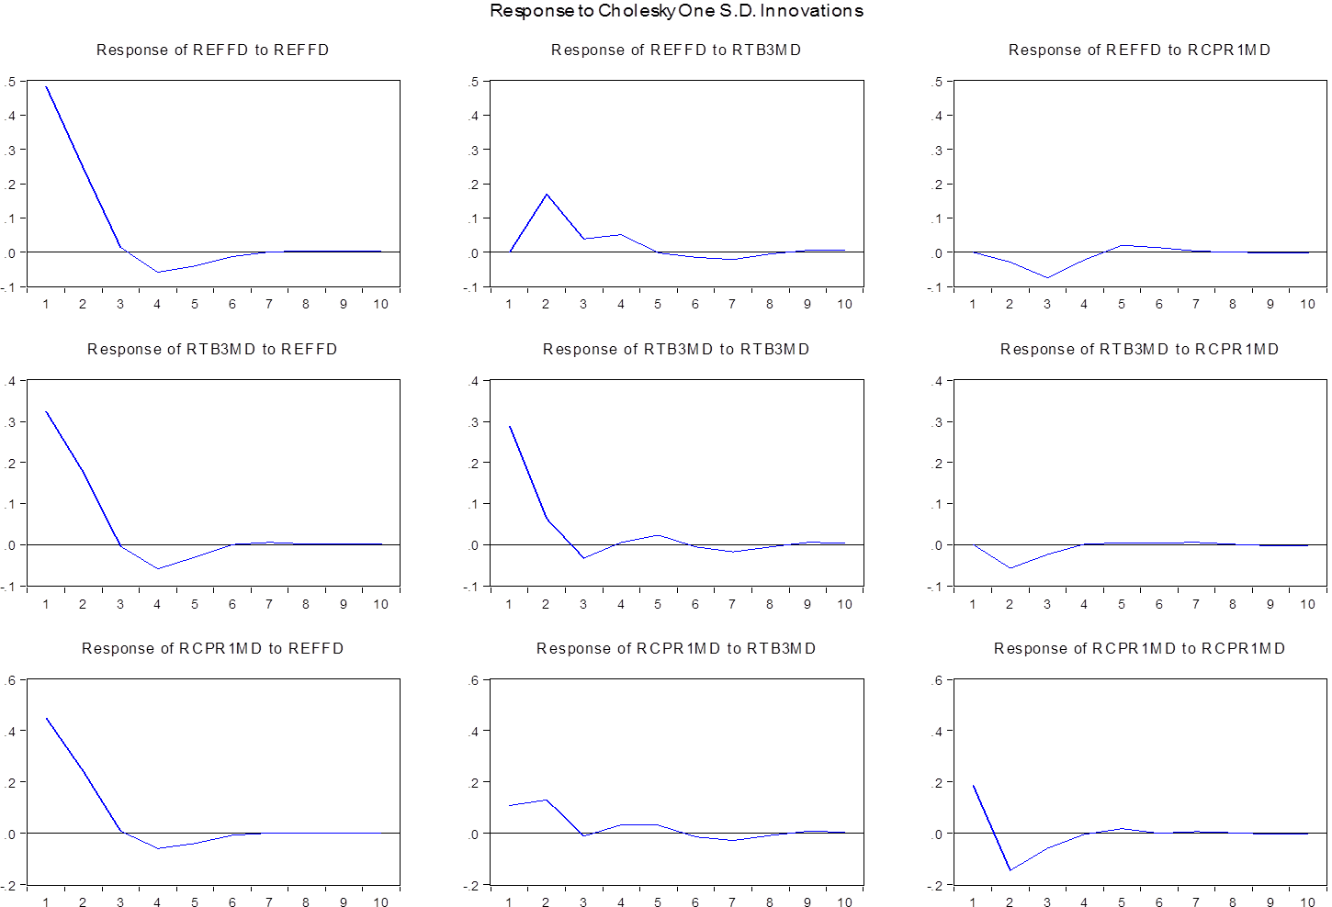
Rates & Impulse Response Functions (Eviews)

Slide 30
VARs/IRFs in Gretl

