Slide 1
Issues in Estimating
Macro Policy Impacts
Note: These slides incorporate and adapt materials from Lacker & Weinberg (Richmond Fed 2007) and Valerie Ramey’s (UCSD) teaching materials

Slide 2
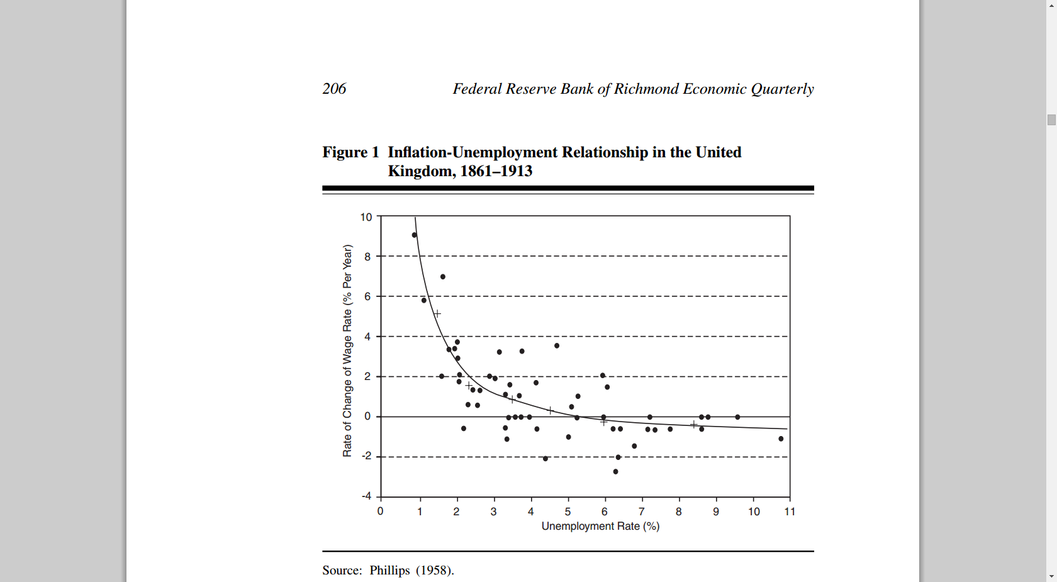
Phillips Curve: 1863-1913
Unemployment(t) = b0 + b1*Inflation(t) b1 <0 and highly significant

Slide 3
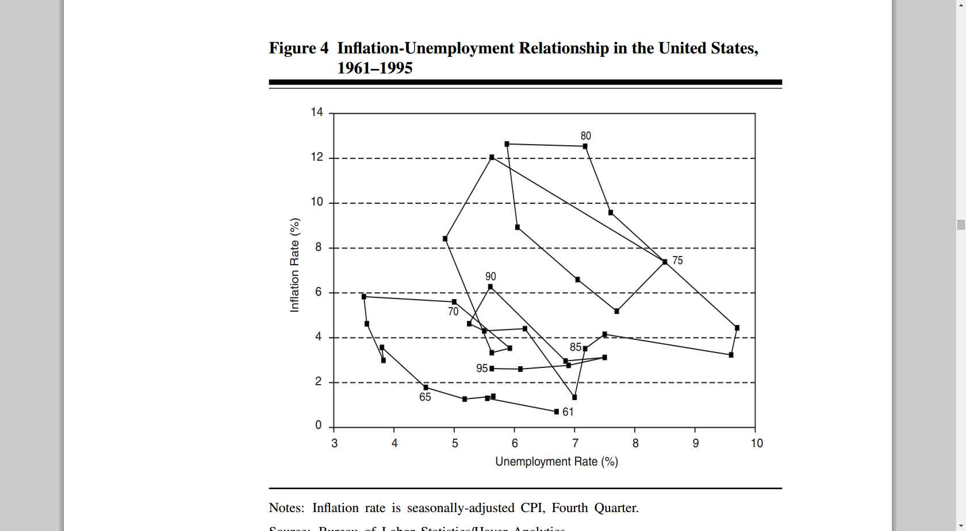
Phillips Curve: 1961-1995
Unemployment(t) = b0 + b1*Inflation(t) b1=0 or very unstable if subsamples used

Slide 4
“Lucas Critique” of Policy
Theory: public responses matter if policy makers try to exploit relationships
Empirical Issues:
  Fed Model: Unemployment(t) = b0 + b1*Inflation(t) + e(t)
  Actual DGP: Unemployment(t) = b0 + b1*Inflation(t) + b2*E(Inflation)(t) + e(t)
  Problem?
  Reason for stable pattern in earlier data, not later data?

Slide 5
Same Problem, Different Variables:
Estimating Policy “Multipliers”
Goal:
  dln(y) = a1*dln(m) + a2*dln(z) + e
    m = monetary stimulus variable
    a1 = monetary stimulus multiplier
  dln(y) = b1*dln(g) + b2*dln(z) + u
    g = fiscal (govt spending) variable
    b1 = fiscal stimulus multiplier
Identification problem(s)
  Endogeneity/Simultaneity
  Omitted variables (z)

Slide 6
Brief Theory Review
Basic ISLM Model
(macroeconometric version; See Webb, Richmond Fed)
(1) Basic GDP definition: Y = C + I + G
(2) Consumption Function: C = C₀ + b₁*[Y- τ*Y]
(3) Investment Function: I = b₂*r
(4) Money Demand Function: M = b₃₁*Y + b₃₂*r + b₃₃*P^{e}
  Multipliers from Model Solution/Derivatives
  Fiscal: dY/dG = b₃₂/{b₃₂[1-b₁(1- τ)] + b₂*b₃₁}
  Money: dY/dM = b₂/{b₃₂[1-b₁(1- τ)] + b₂*b₃₁} + b₃₃*(dP^{e}/dM)

Slide 7
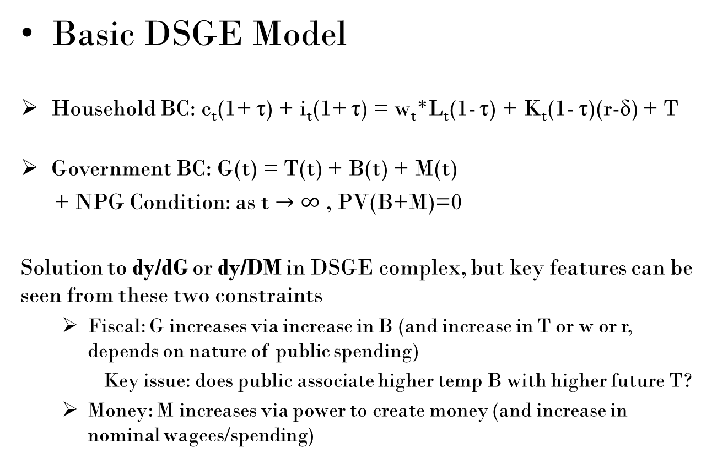
Brief Theory Review
Basic DSGE Model
Household BC: c_{t}(1+ τ) + i_{t}(1+ τ) = w_{t}*L_{t}(1- τ) + K_{t}(1- τ)(r-δ) + T
Government BC: G(t) = T(t) + B(t) + M(t)
+ NPG Condition: as t $→∞$ , PV(B+M)=0
Solution to dy/dG or dy/DM in DSGE complex, but key features can be seen from these two constraints
  Fiscal: G increases via increase in B (and increase in T or w or r, depends on nature of public spending)
  Key issue: does public associate higher temp B with higher future T?
  Money: M increases via power to create money (and increase in nominal wagees/spending)

Slide 8
Summary of Theory & Multipliers
Fiscal Stimulus Multipliers (Government Spending or Tax)
  ISLM Impact
    G increases Y while MPC & degree of investment “crowding out” and other partial effects (slopes of IS and LM) determine size of effect
    Larger impact when near zero rates (slope of LM very low so crowding out low)
  DSGE Impact
    Impact of G hinges on degree of public view of future taxes and offsetting reduction in C
    If future tax impact offsets, then any impact based on relative productivity of C versus G
Monetary Stimulus Multipliers
  ISLM Impact
    M increases Y while slopes of IS and LM determine size of effect
  DSGE Impact
  Increase in M increases all nominal values
    Impact requires fixed or slow wage/price response
Empirical Debates
  Size of MPC (1960s/70s)
  Size of Crowding out (1960s-80s)
  Degree of public response/expectations of taxes, inflation (1970s – present)
  Estimation of dy/dG, dy/dM (1950s-)

Slide 9
Estimation of Multipliers:
ID Experimental Design Context (See Ramey)
Y = b0 + b1*X + b2*Z
Treatment Group: apply variable X to group
Control Group: do not apply X to group while keeping all other variables (Z) constant between the two groups
Random Assignment to Groups
  Exogeneity of treatment (X is applied to Y, not vice versa)
  Randomizes indirect effects of Z on X
Ideal Macro Policy Application
  Randomly assign countries to two groups
  Apply treatment to one group (Ex: natural experiment like Korea)
  Hold Z constant between two groups
    Ex: natural experiments like Korea
    If Z not constant, measure-include Z variables in model

Slide 10
Limits & Challenges
Data Limits
  Single country time series data means Treatment/No Treatment groups defined by years, not across different units; No random assignment, so treatment not exogenous by design (explanatory “treatment” may be endogenous itself – including dependence on Y)
  Panel data (cross country over time) with no random assignment; mix of treatments across countries/time
  Defining meaning of “treatment” (metrics; on/off v. continuous)
  Imprecise model specification so Zs and impact uncertain
Identification/Estimation Challenges
  Constructing exogeneity strategies
    Natural experiments that generate exogenous treatments
    “Instrumentize” the treatment variable
  Instruments: Where treatment variable is not exogenous, looking for a variable (an instrument) that predicts the treatment but is not (substantially) correlated with the dependent variable or a variable that can stand in for the treatment
    Instrumental Variables Regression/VAR Methods
    Other Instruments (Ex: Ramey)
    Timing Matters: Instruments /Intrumentized variable should be unanticipated (otherwise, not really exogenous)
    Duration Matters: Temporary v. Permanent Variables (in stimulus context, looking for temporary variables)
    Relevance Matters: instrument should have predictive ability (otherwise “weak”)
  Control group/variables strategies
    Theory; estimation methods; quasi-experimental methods (synthetic controls; matching)

Slide 11
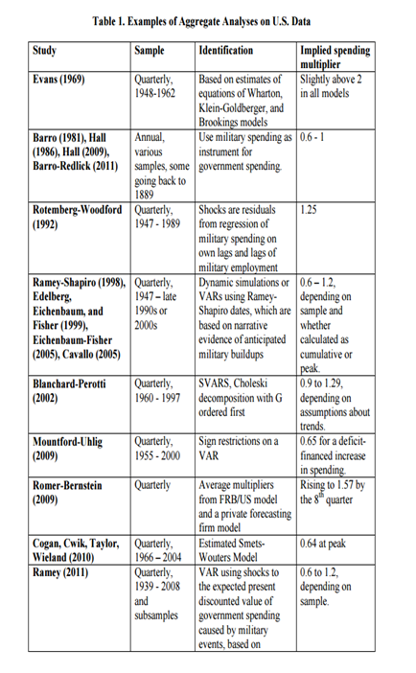
Ramey JEL Review of G Multipliers

Slide 12
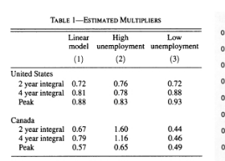
Ramey (2013 AER) Does “Slack” Matter
For Size of Fiscal Multiplier?

Slide 13
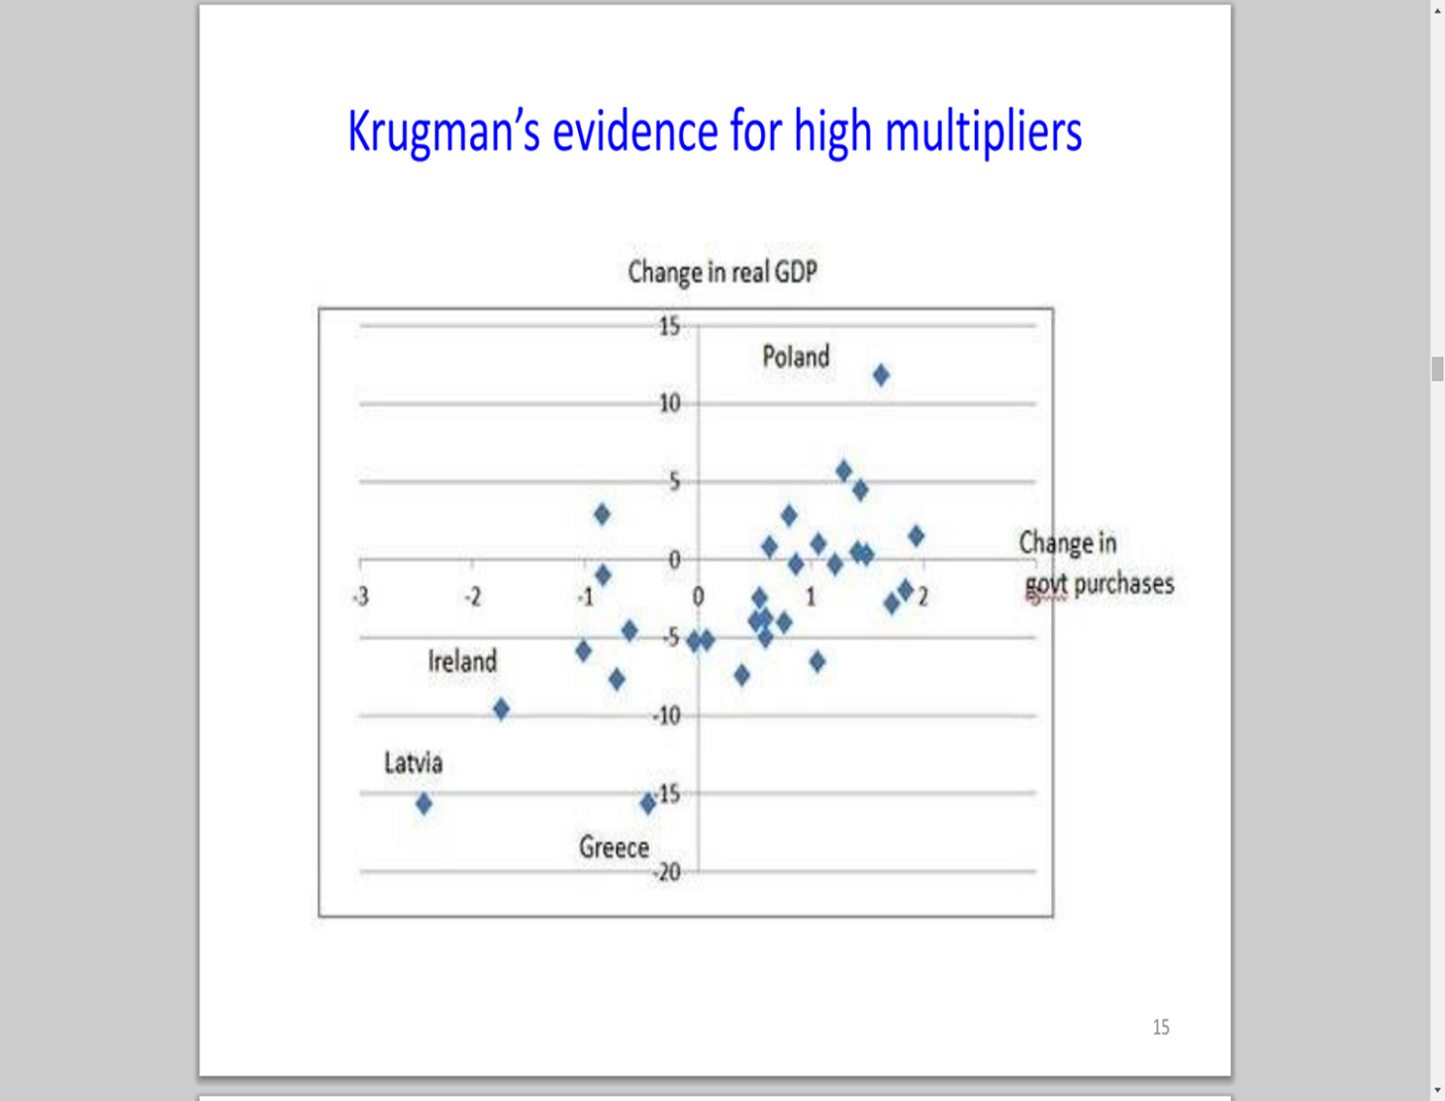
Fiscal Multipliers
Krugman: Simple Evidence

Slide 14
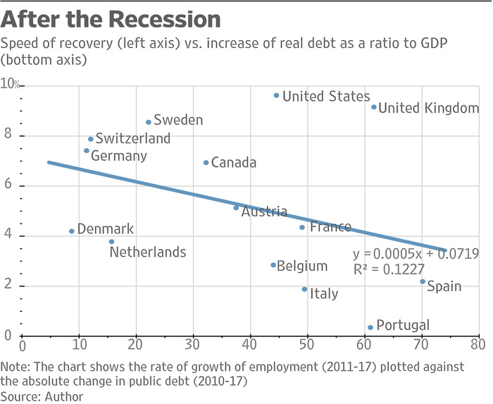
Phelps (WSJ 2018)
Simple Evidence Contra Krugman

Slide 15
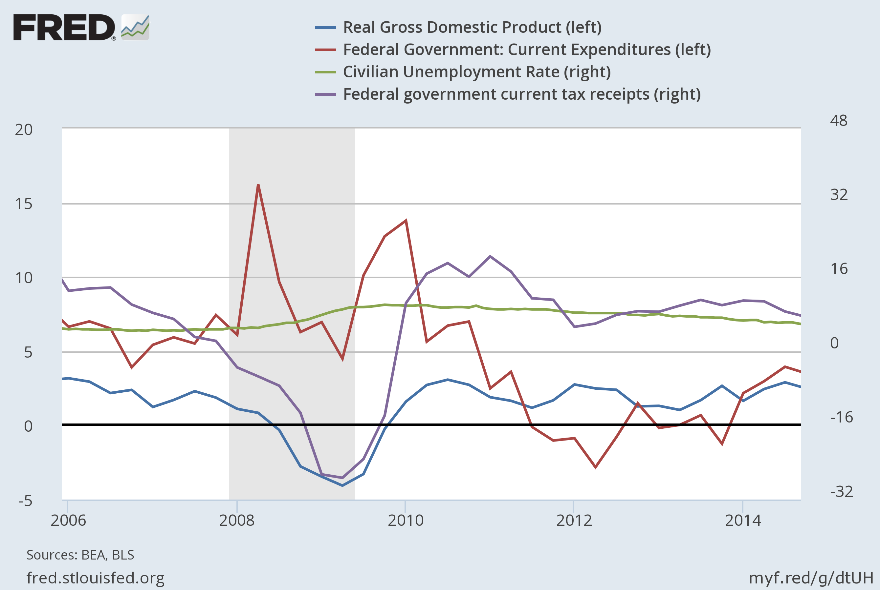
More Simple Evidence

Slide 16
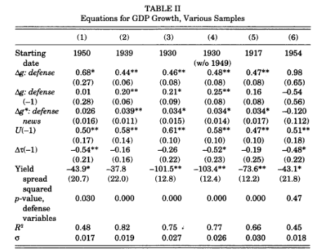
Barro Fiscal Multiplier Estimates
Using Military Spending as Instrument (QJE 2011)

Slide 17
Going Beyond Simple Evidence:
Sampling of Fiscal Multiplier ID Strategies
War as type of natural experiment
  War as an instrument to predict expenditures (Barro)
  Essentially:
  dg = a1 * a2*War + e; save dgpredicted
  dy = b1 * b2*dgpredicted + b3*Z + u
  Desirable Features of War/dgpredicted?
  Weaknesses?

Slide 18
Beyond Simple Evidence:
Sampling of Fiscal Multiplier ID Strategies
Instrumental Variables Methods & Strengths/Weaknesses
  Wartime expenditures as instrument (Barro)
  VAR shocks (errors) as instrument (various)
  Narrative-based instrument
    Business Week “news” about spending as instrument (Ramey reading)
  Controls Always an Issue
Simulations Based on Theory/Stat Models
  US-FRB Model
  DSGEs

Slide 19
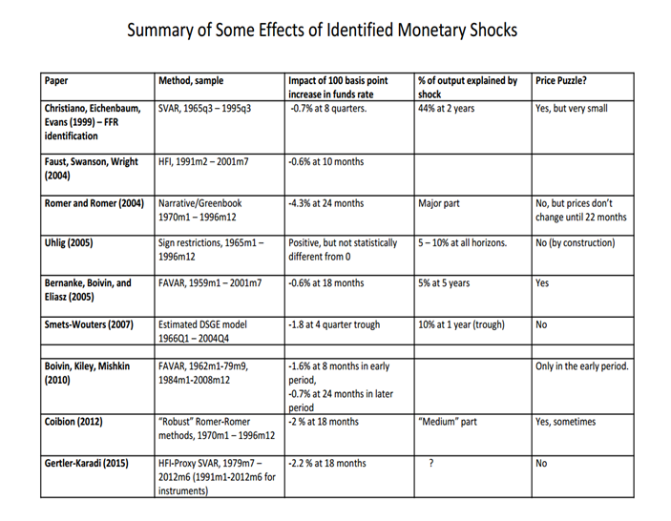
Ramey Review of Monetary Policy Effects

Slide 20
Sampling of Strategies to ID Monetary Stimulus Effects
Simple Correlations
  Example: Friedman & Schwartz Monetary History of U.S.
  Problems
    Measuring impact of money on GDP or impact of GDP on rates?
    Measuring impact of Fed on rates/real variables or impact of rates/real variables on Fed?

Slide 21
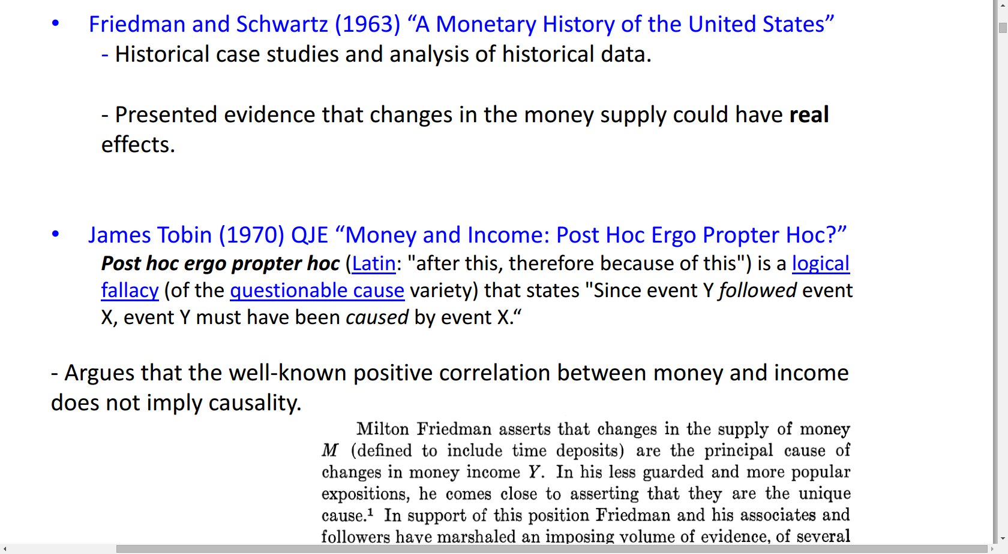
Money & Income:
Friedman & Schwartz + Tobin Critique

Slide 22
Sampling of Strategies to Estimate
Monetary Stimulus
Instrumental Variables
  Barro 2-Stage Regression Method

Slide 23
A Barro-esque ID Strategy
Note: Pred/Res from AR(3) Model using SA data

Slide 24
Same Strategy using URate

Slide 25
Strategies to Estimate Monetary
Stimulus Effects
Simple Correlations (Friedman & Schwartz)
Two-Stage Instruments (Barro)
VAR Shocks as instrument (various)

Slide 26
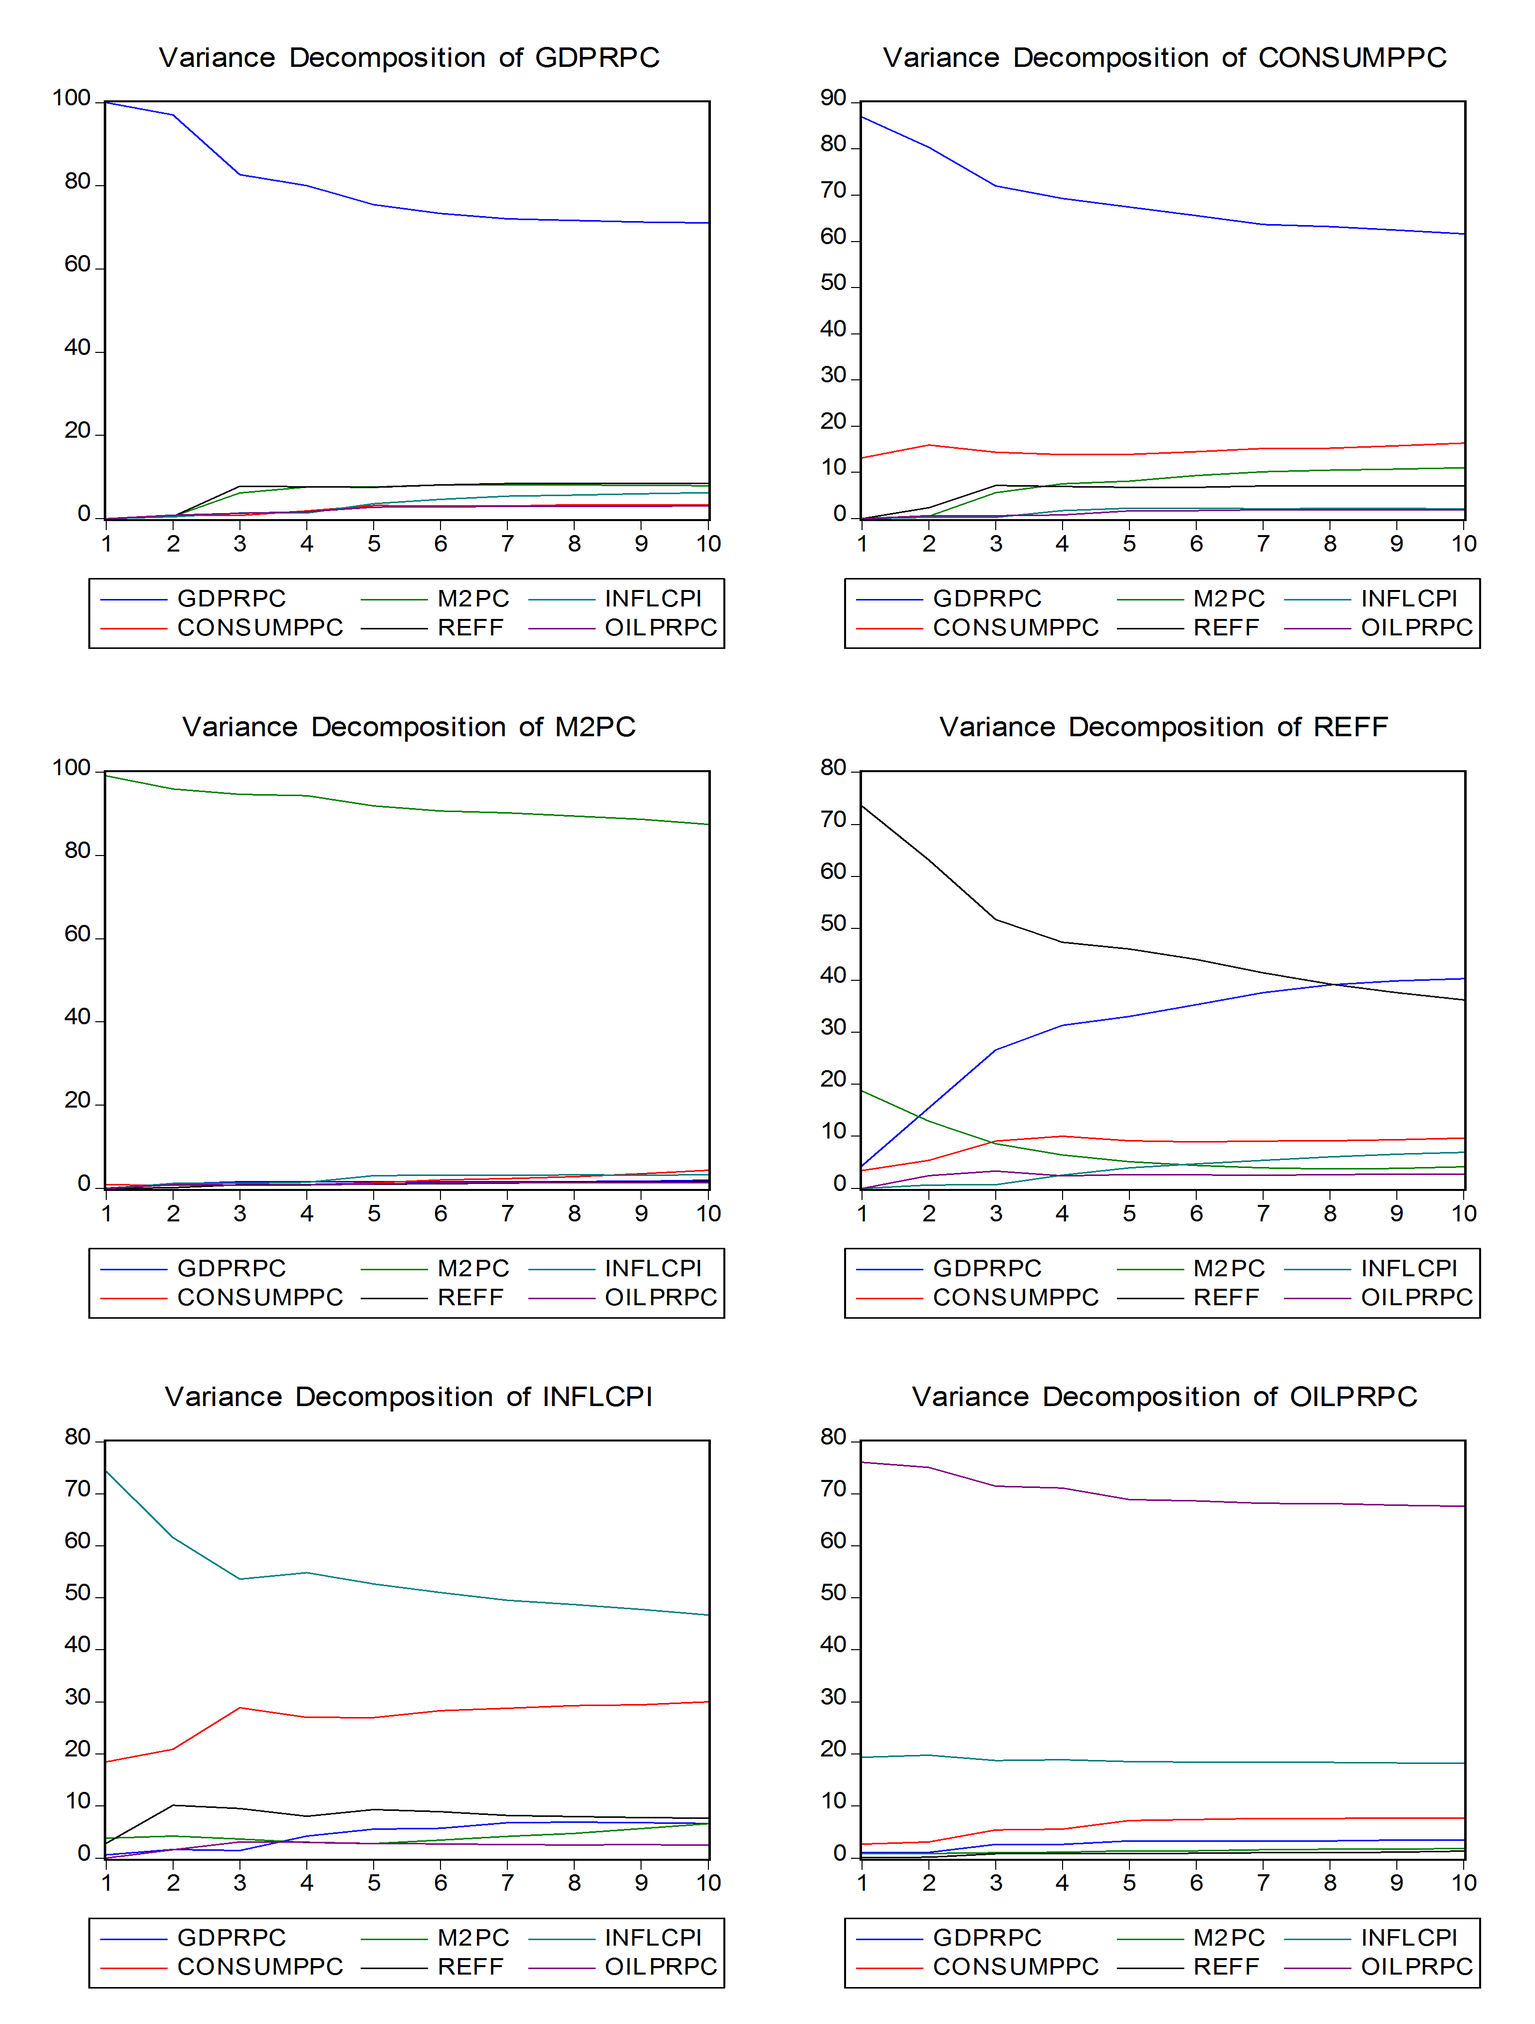
VAR VD for Simple VAR

Slide 27
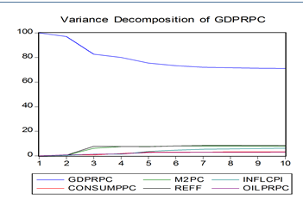
M2 Impact on Y
In VAR

Slide 28
Sampling of Strategies to Estimate
Monetary Effects
Simple Correlations (Friedman)
Instruments
  Barro & Predicted/Residual Money
  VAR Shocks as instrument (various)
    Weakness?
  Narrative-based methods (See Ramey)
DSGE, Theory-Based Simulations (various)

