Slide 1
Business Cycles

Slide 2
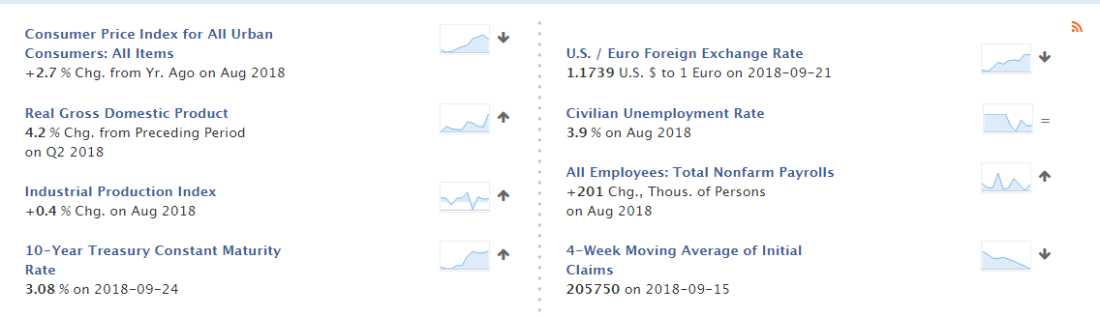
Recent Economic Data

Slide 3
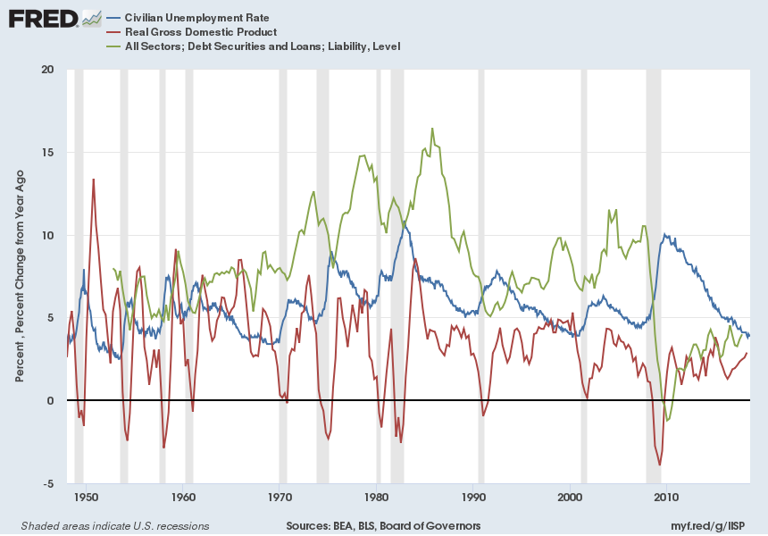

Slide 4
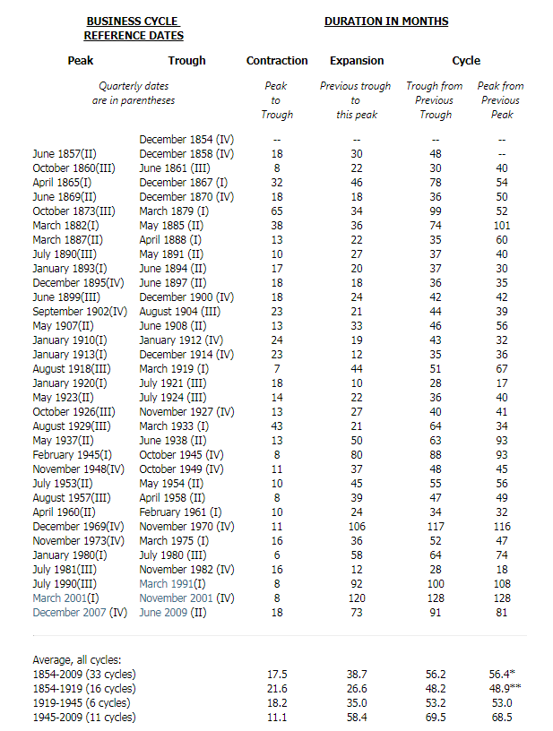
NBER Business Cycle Dates

Slide 5
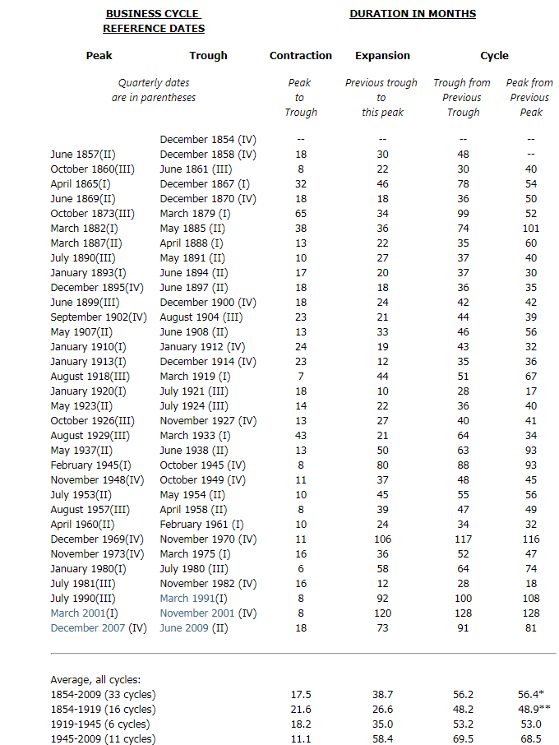
NBER
Official
Business
Cycle
Dates

Slide 6
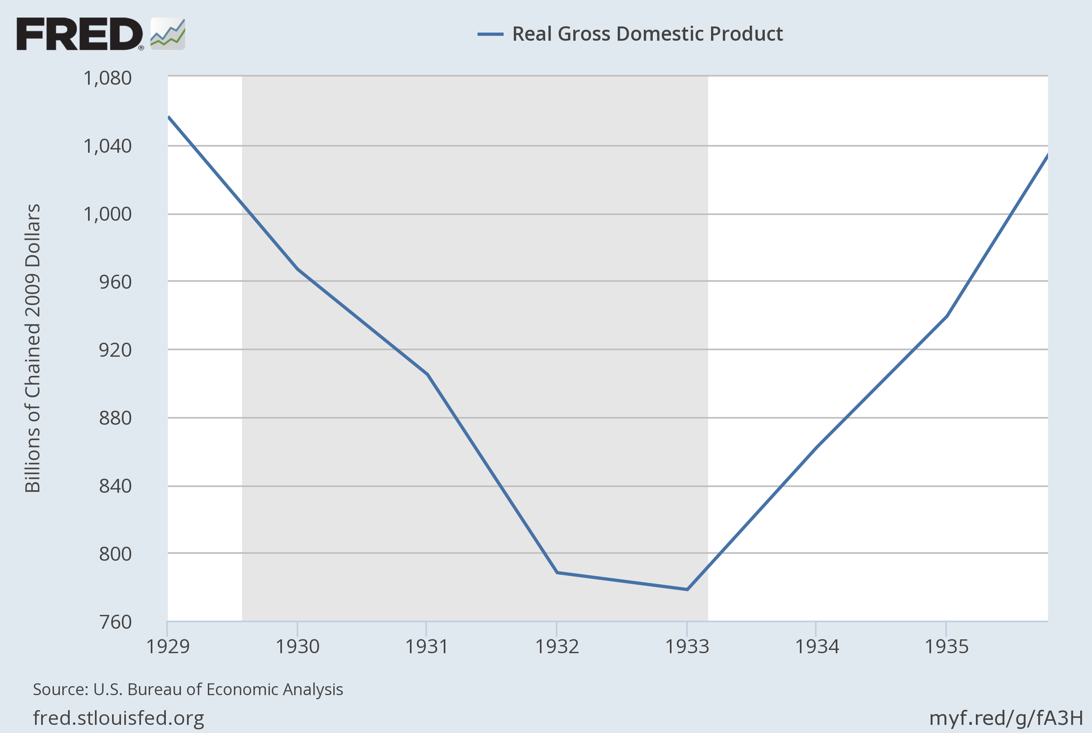
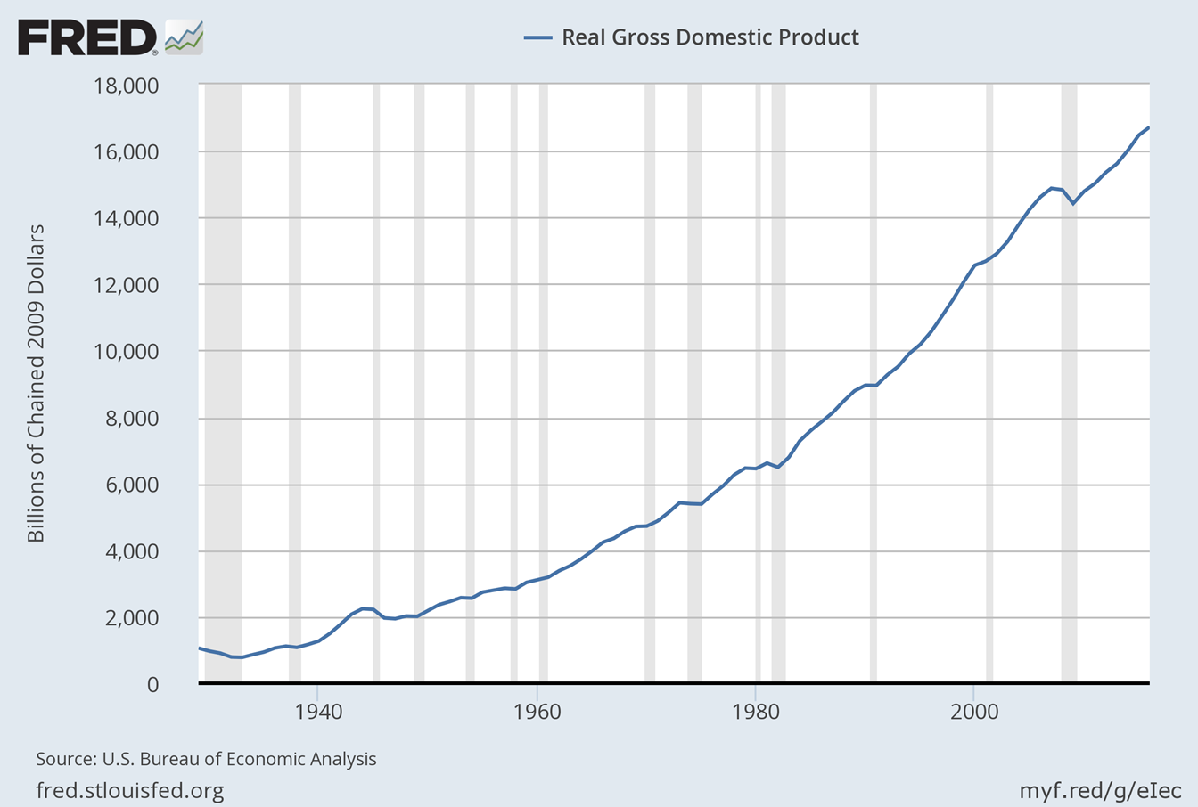
90-Year Perspective on Recessions

Slide 7
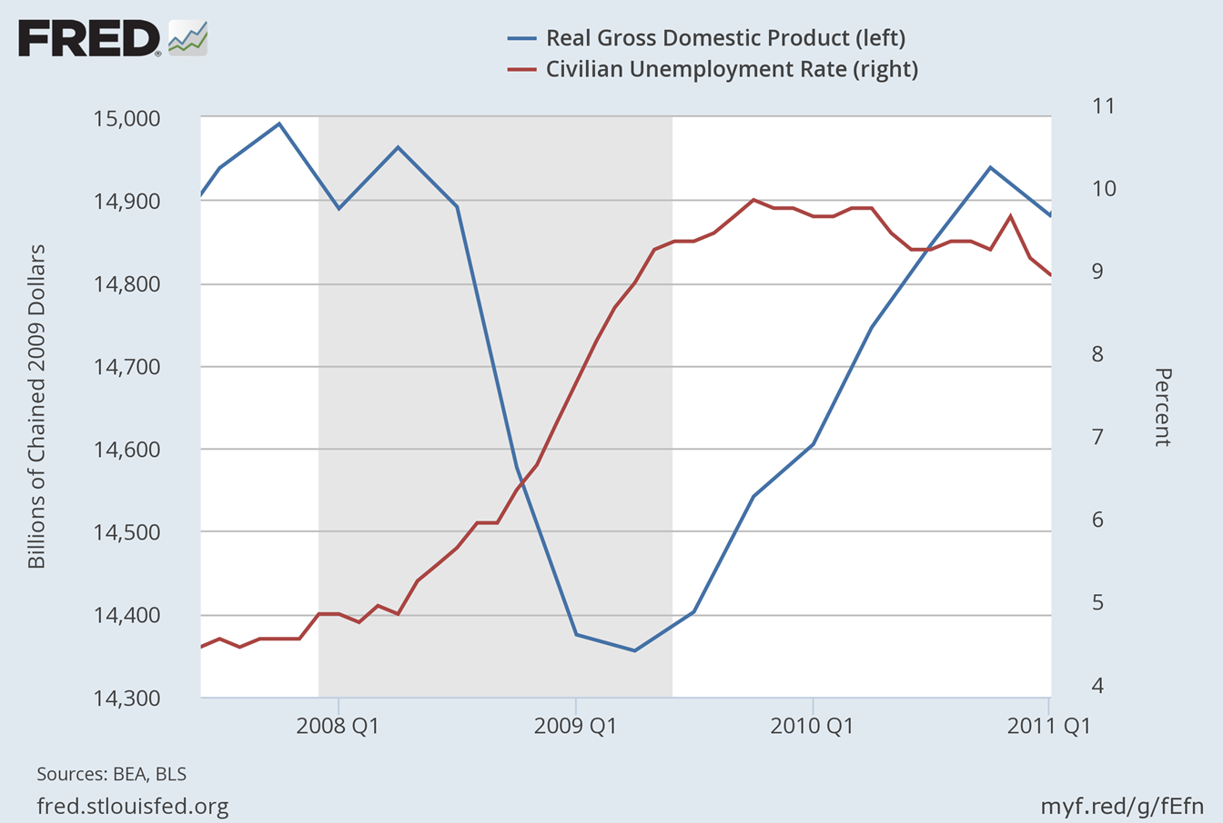

“Great Recession” of 2007-09
Unemployment Rate
Incomes
Fall 5%

Slide 8
Distribution of
Annual Percent Change in GDP (09 $)

Slide 9
The Business Cycle
Across Selected Econ Sectors
Industry | Correlation with Movements in Real GDP
Advertising | Very High
Construction | Very High
Oil & Gas | High
Entertainment | High
Clothing | High-Mid
Restaurant-Dining | Low
Regional Banks | Low
Grocery & Food Retail | Very Low
Utilities | Very Low

Slide 10
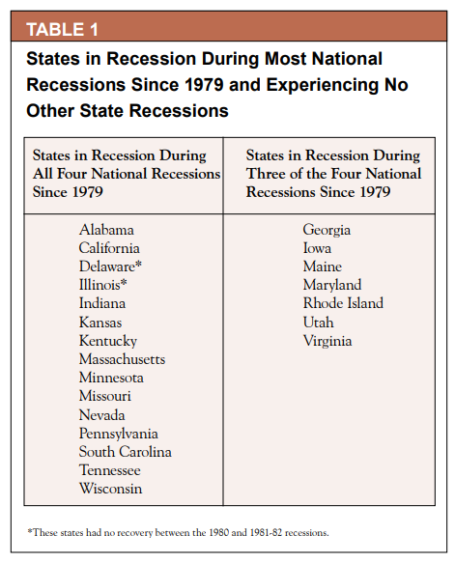
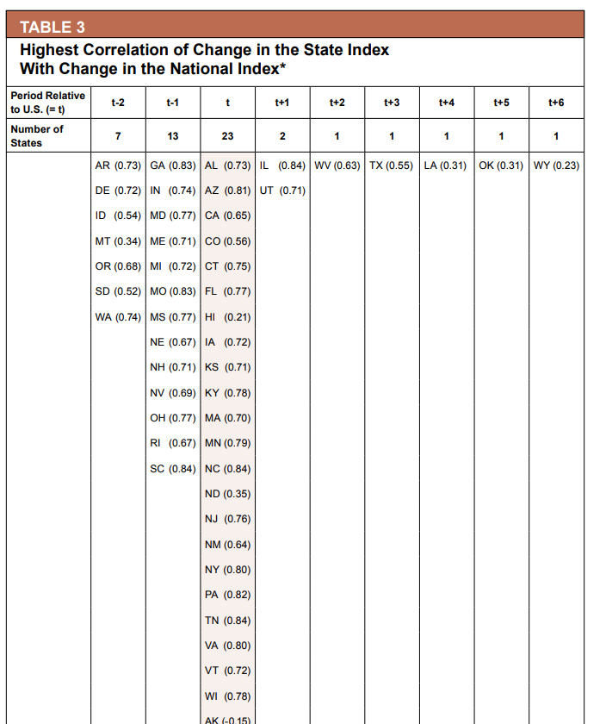
Relationship of State & National Cycles

Slide 11
GDP w/o Seasonal Adjustment

Slide 12



Business Cycle Models
Suppose economy described by
    Except A = A^{z(t)} ; z(t)= z(t-1) + e; e is N(0, sigma)
Now DGE become DSGE;
Simple Version of “Real Business Cycle” Model
For details on solving base RBC model see
Uhlig

Slide 13
DSGE’s with
Additional Complexity
More Complex Preferences
  Different kinds of households
  Habits …
More Sectors
  Financial/Credit
  Government
  Money
  International
Frictions
  Sticky wages/prices
  Biased/sticky expectations

Slide 14
Shocks & Amplifiers
Sources of Shocks
Amplifiers (propagators)
Consumer outlook/discounting
“Tech” Shifts
  Tech Change
  Resource Costs
Sector/Structural Shifts
Financial Booms/Busts
Policy Mistakes
Wage rigidity
Price Rigidity
Expectation errors

Slide 15
VAR & Shocks

Slide 16
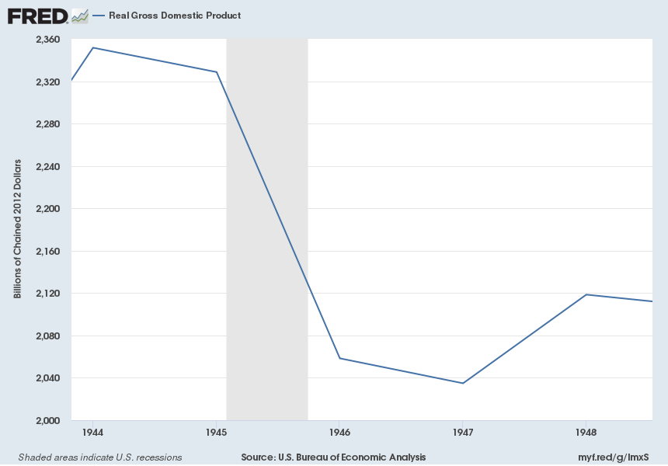
Sector Shifts: A Natural Experiment

Slide 17
Sector
Shifts?

Slide 18
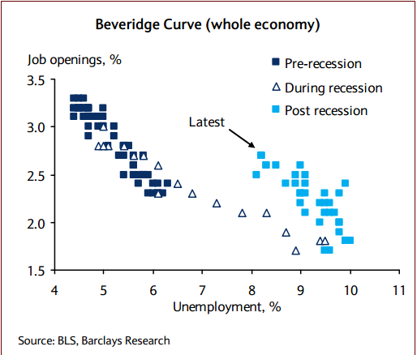
Sector Shift Seen in Beveridge Curve?

Slide 19
Oil Prices & Recessions

Slide 20
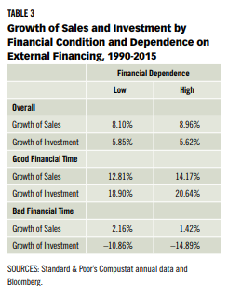
Financial Dependence
& Economic Performance

Slide 21
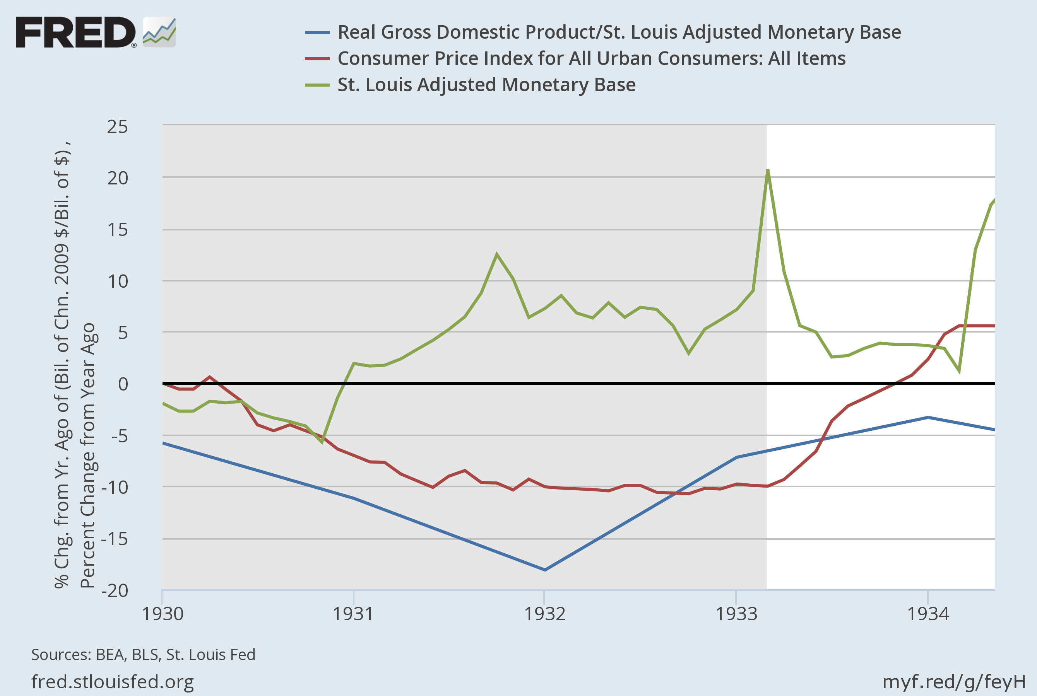
Policy Mistakes
Monetary Base
CPI
Velocity of Money

Slide 22
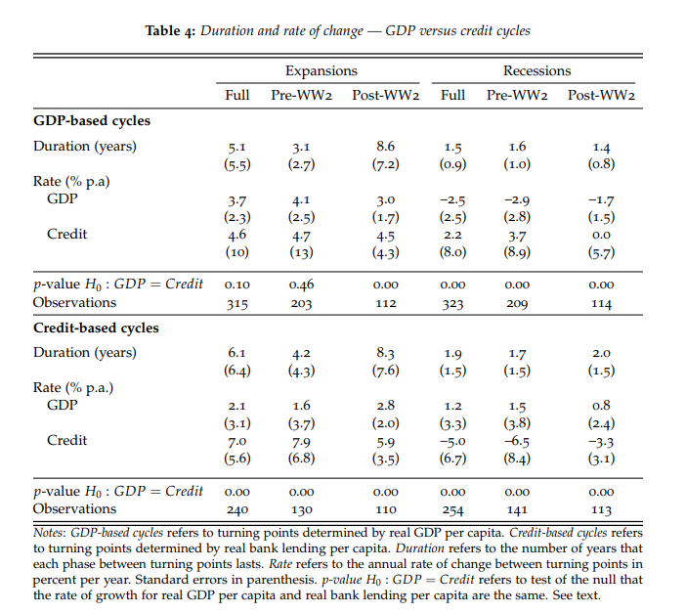
Financial Market Booms/Busts

