Slide 1
Aggregate Price Measures &
Technological Change

Slide 2
Long Run Effects of CPI Mismeasurement

Slide 3
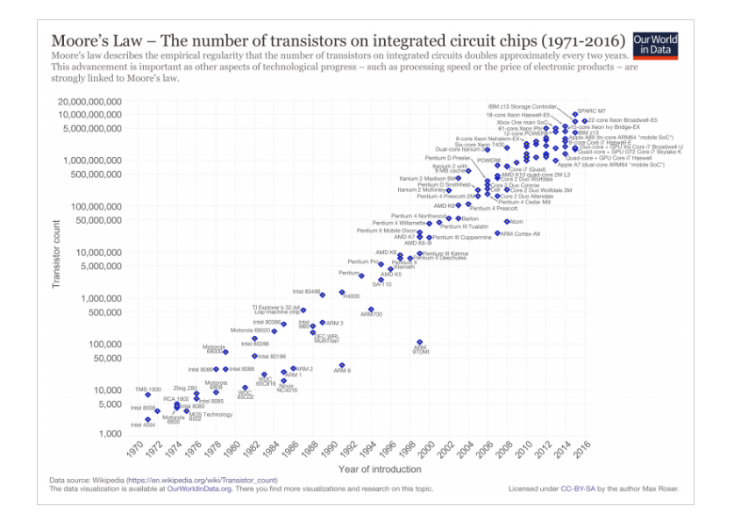
Indicator of Technology Change

Slide 4
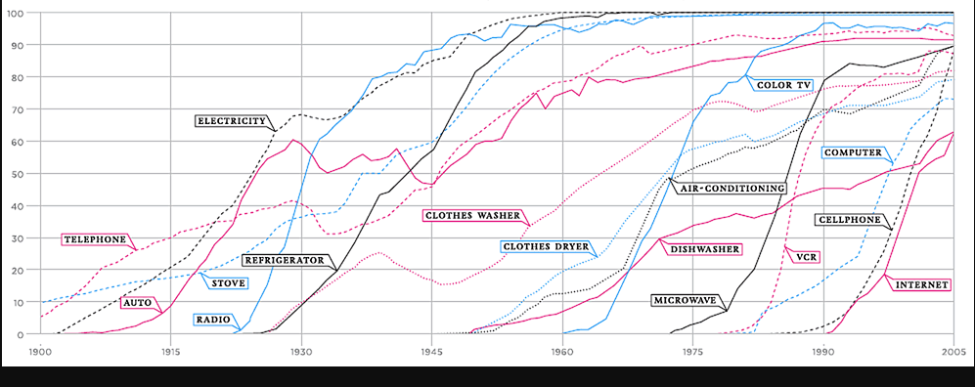
100+ Years of Tech Adoption by U.S. Households
(NBER Comin & Hobjin 2009)

Slide 5
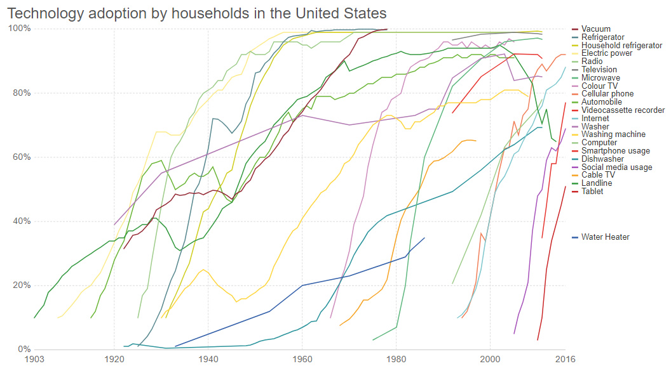
Updated Version

Slide 6

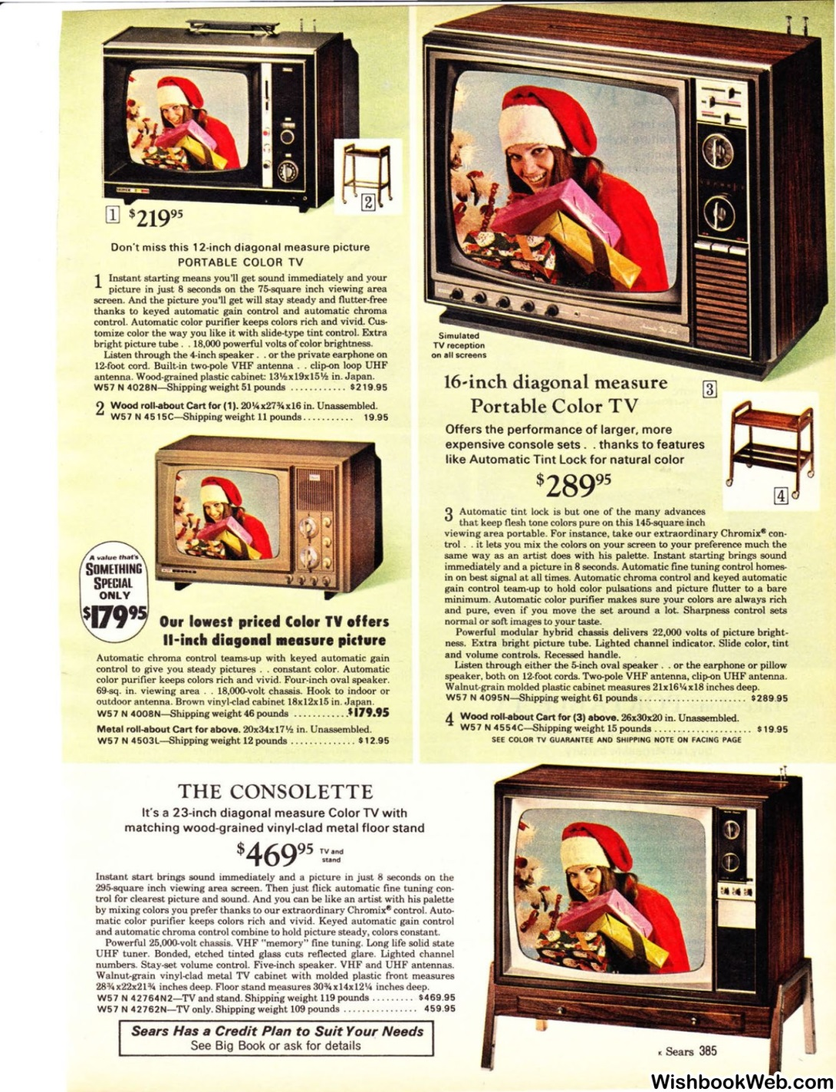

Slide 7
Sears-based Index
  Prices (nearly) equivalent items from Sears catalogues over time
    Microwave oven, color tv, washer, dryer, dishwasher, electric range, fridge, mower…
  Compute hours of labor needed to purchase item
  (purchasing power of hour of labor)
    = price item/avg wage rate (non-supervisory employees)
  Generate factor scores based on factor analysis of these hrs for each item (declining series)
  Invert the factor scores (1/factor) as indictor of underlying common tech progress

Slide 8
Purchasing Power of Hour of Labor

Slide 9
Tech Index by
Alternative Methods

